Slide 1
GREAT OUTDOOR
TEAM E

Slide 2
“
Progress Update
Done with data base integration.
Done with the implementation of all Microservices–
Signup Login
Admin login
Product Category
Customer Data
Order Management
Returns
Payment
Inventory
Shipping
Authentication and Authorization
Implemented CRUD operations for all microservices.
Connected these microservices with Service registry and integrated with API Gateway.
Achieved Junit Test cases for these microservices.
Added Exception Handling for Admin login, Signup, Product category, Customer data, Inventory.

Slide 3
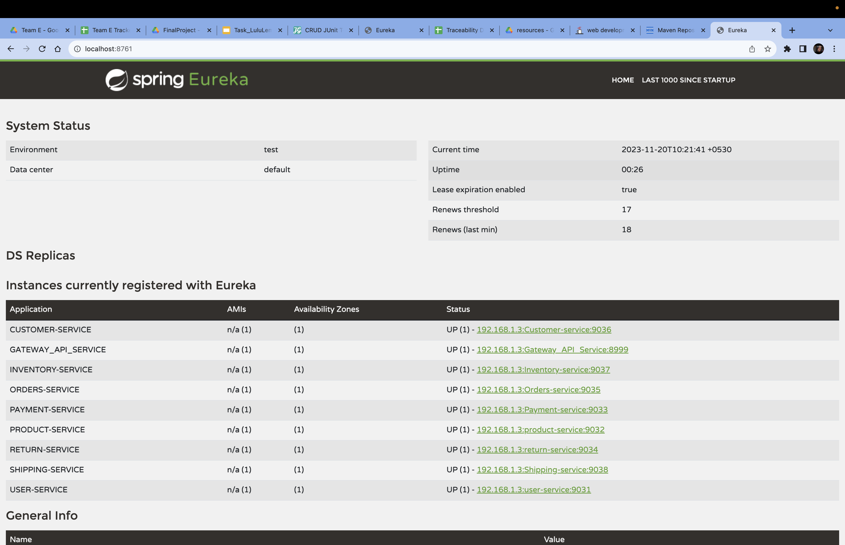
“
Eureka

Slide 4
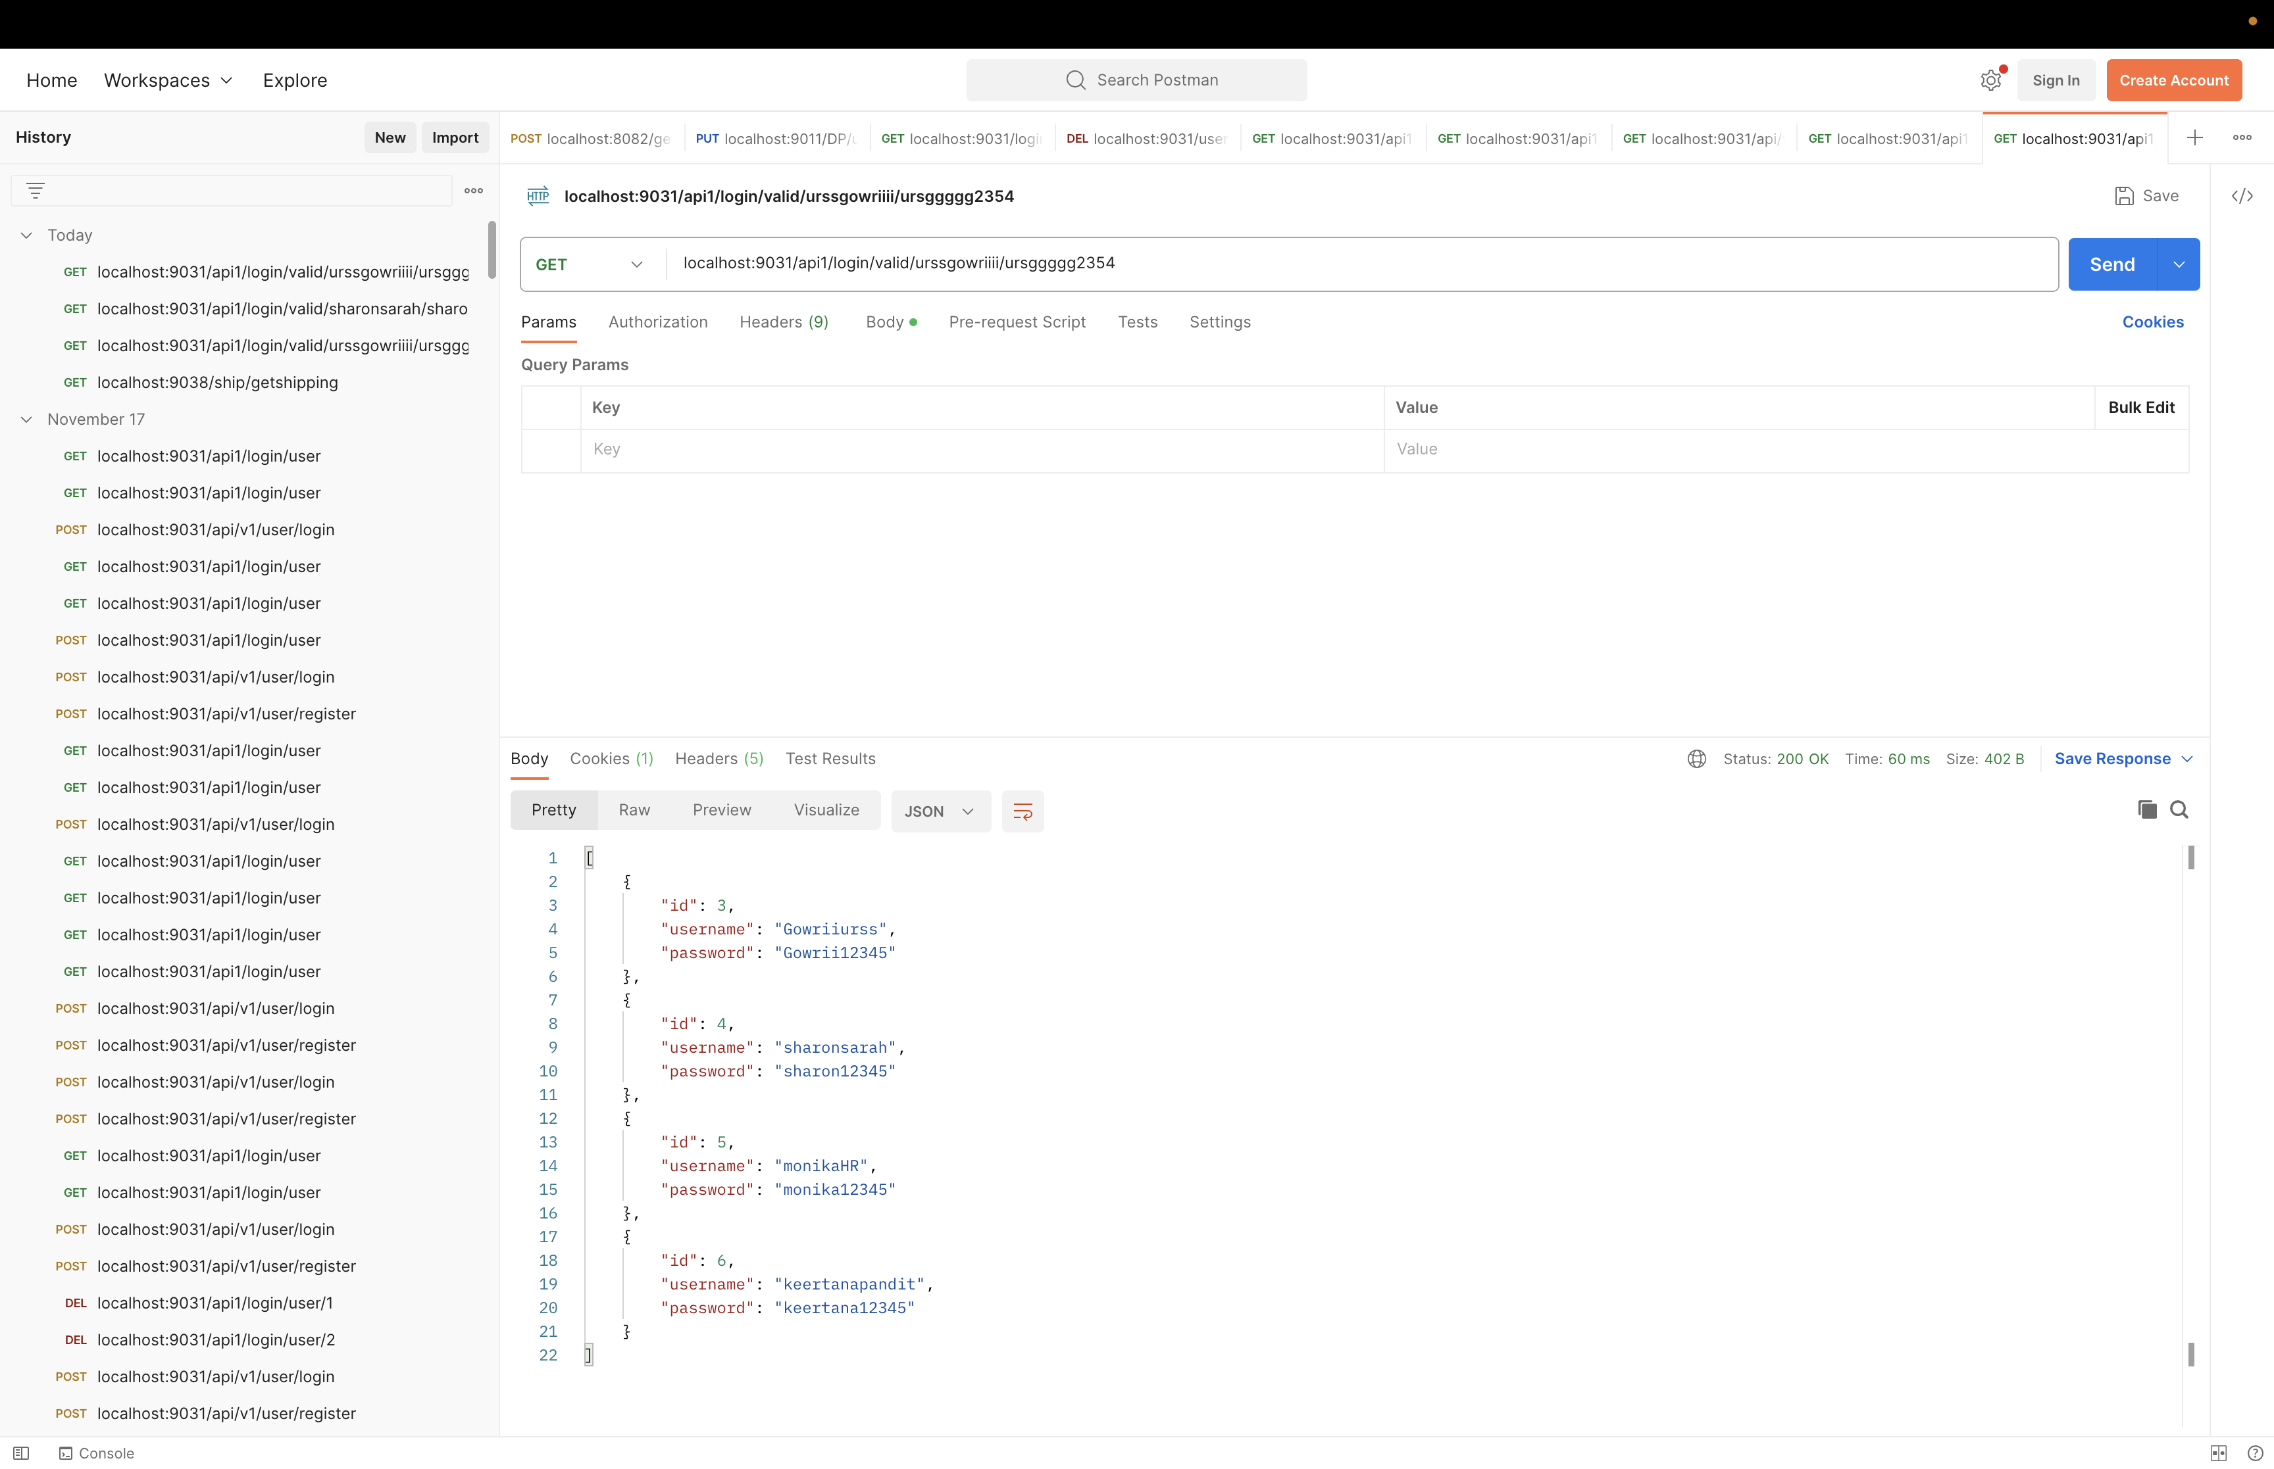
“
Authentication-Not Valid

Slide 5
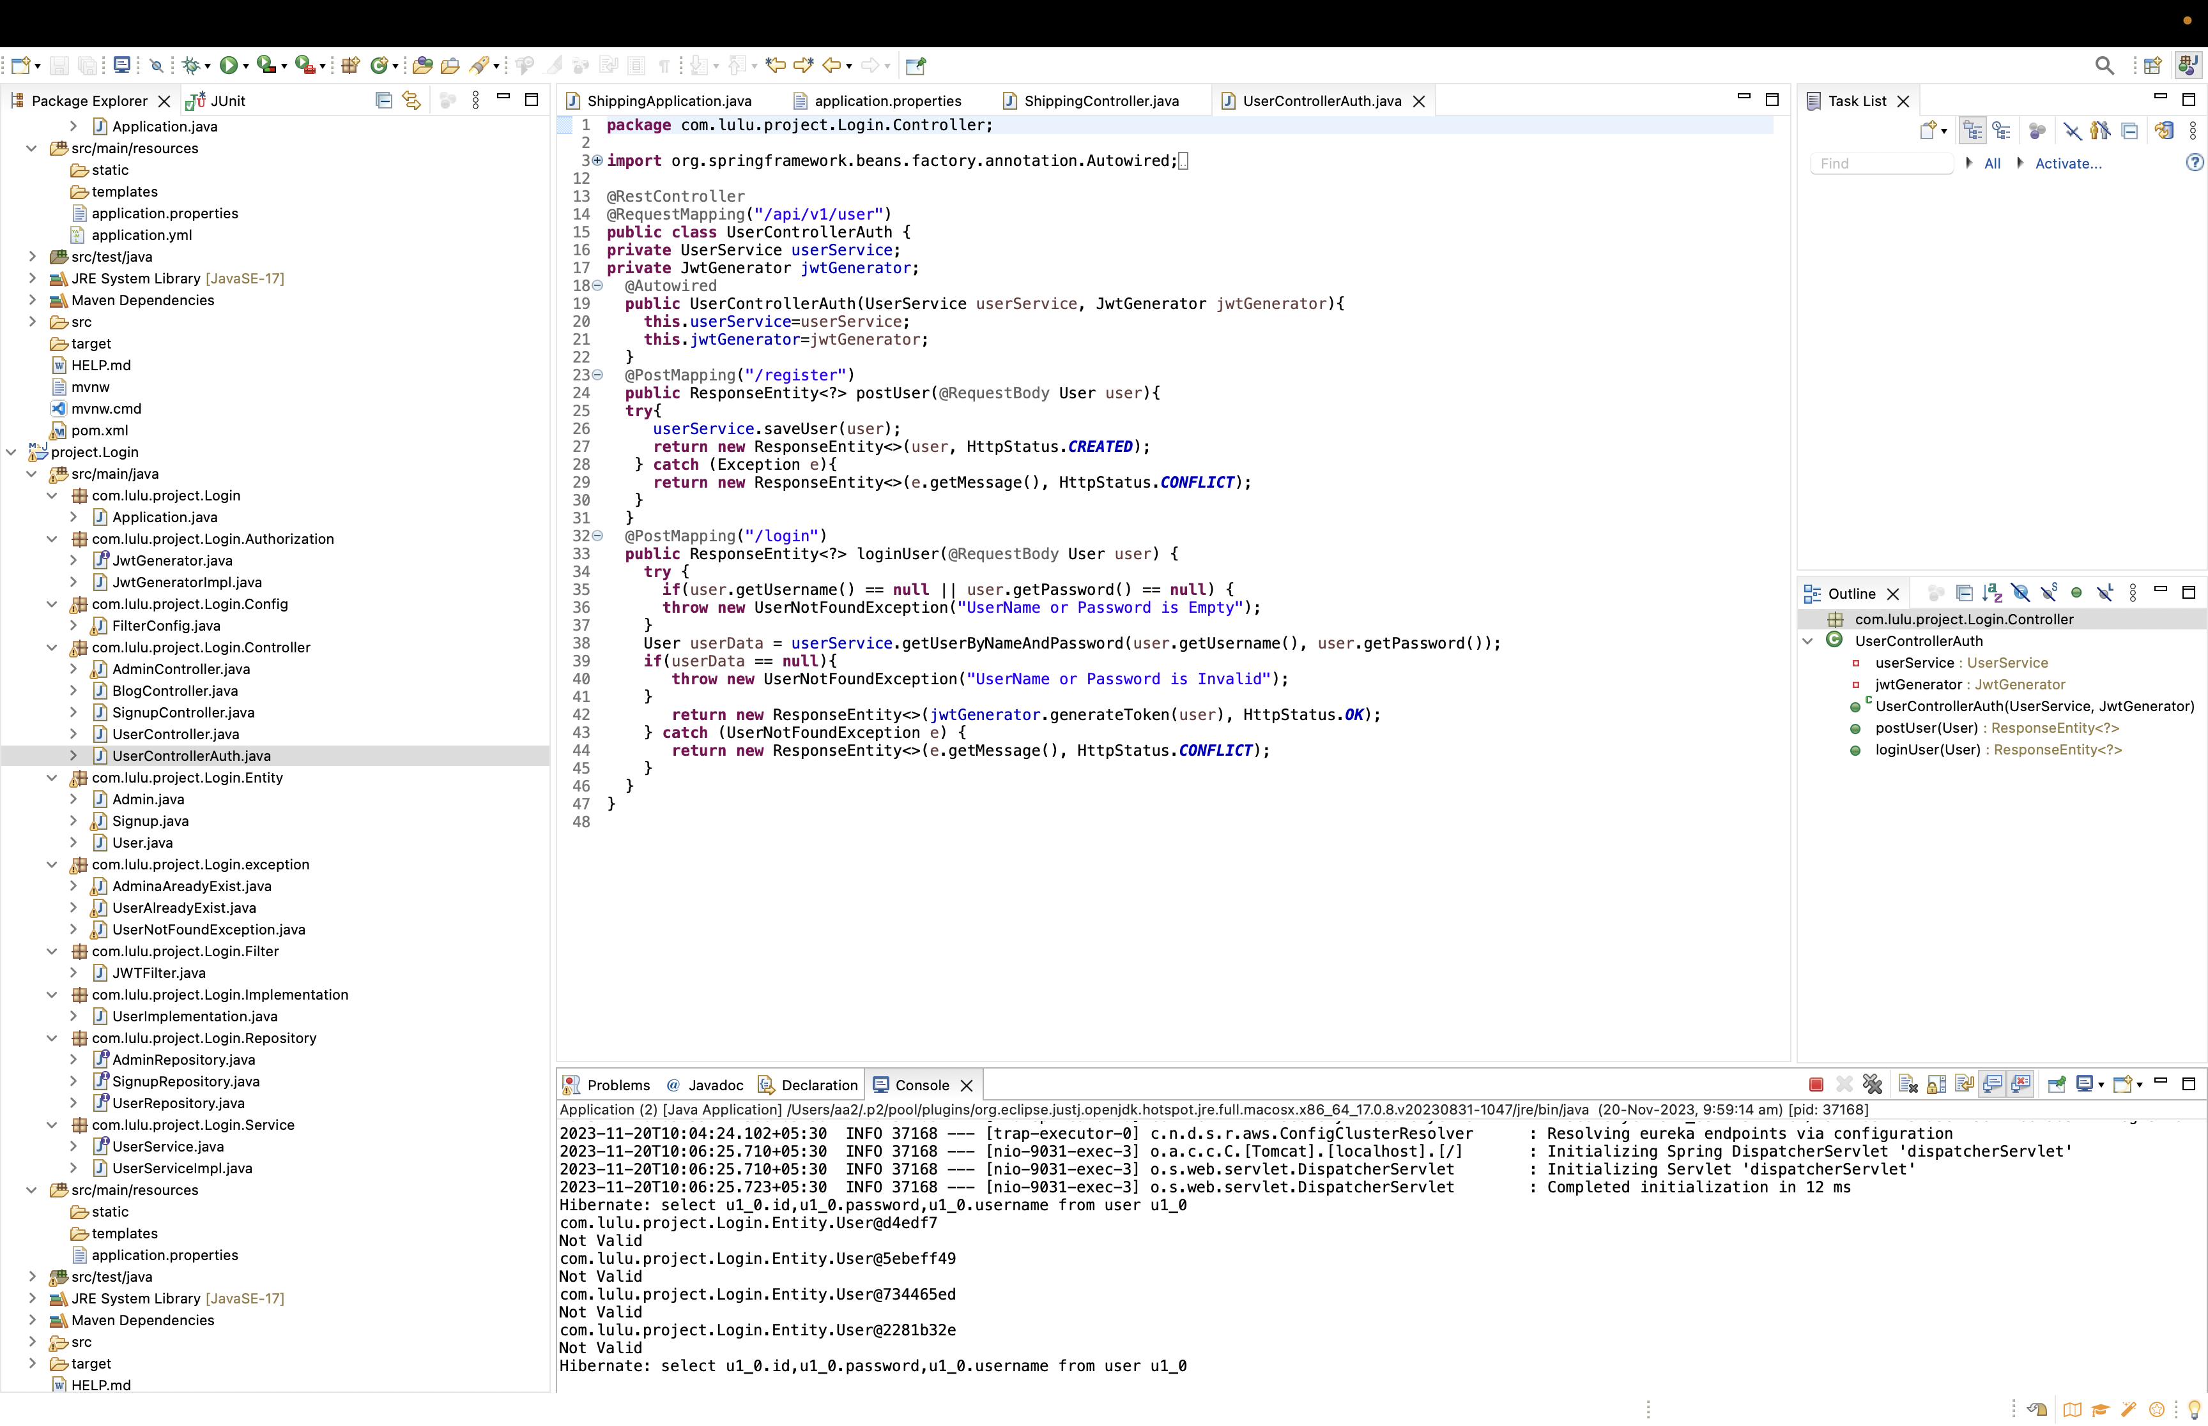
“
Authentication-Not Valid

Slide 6
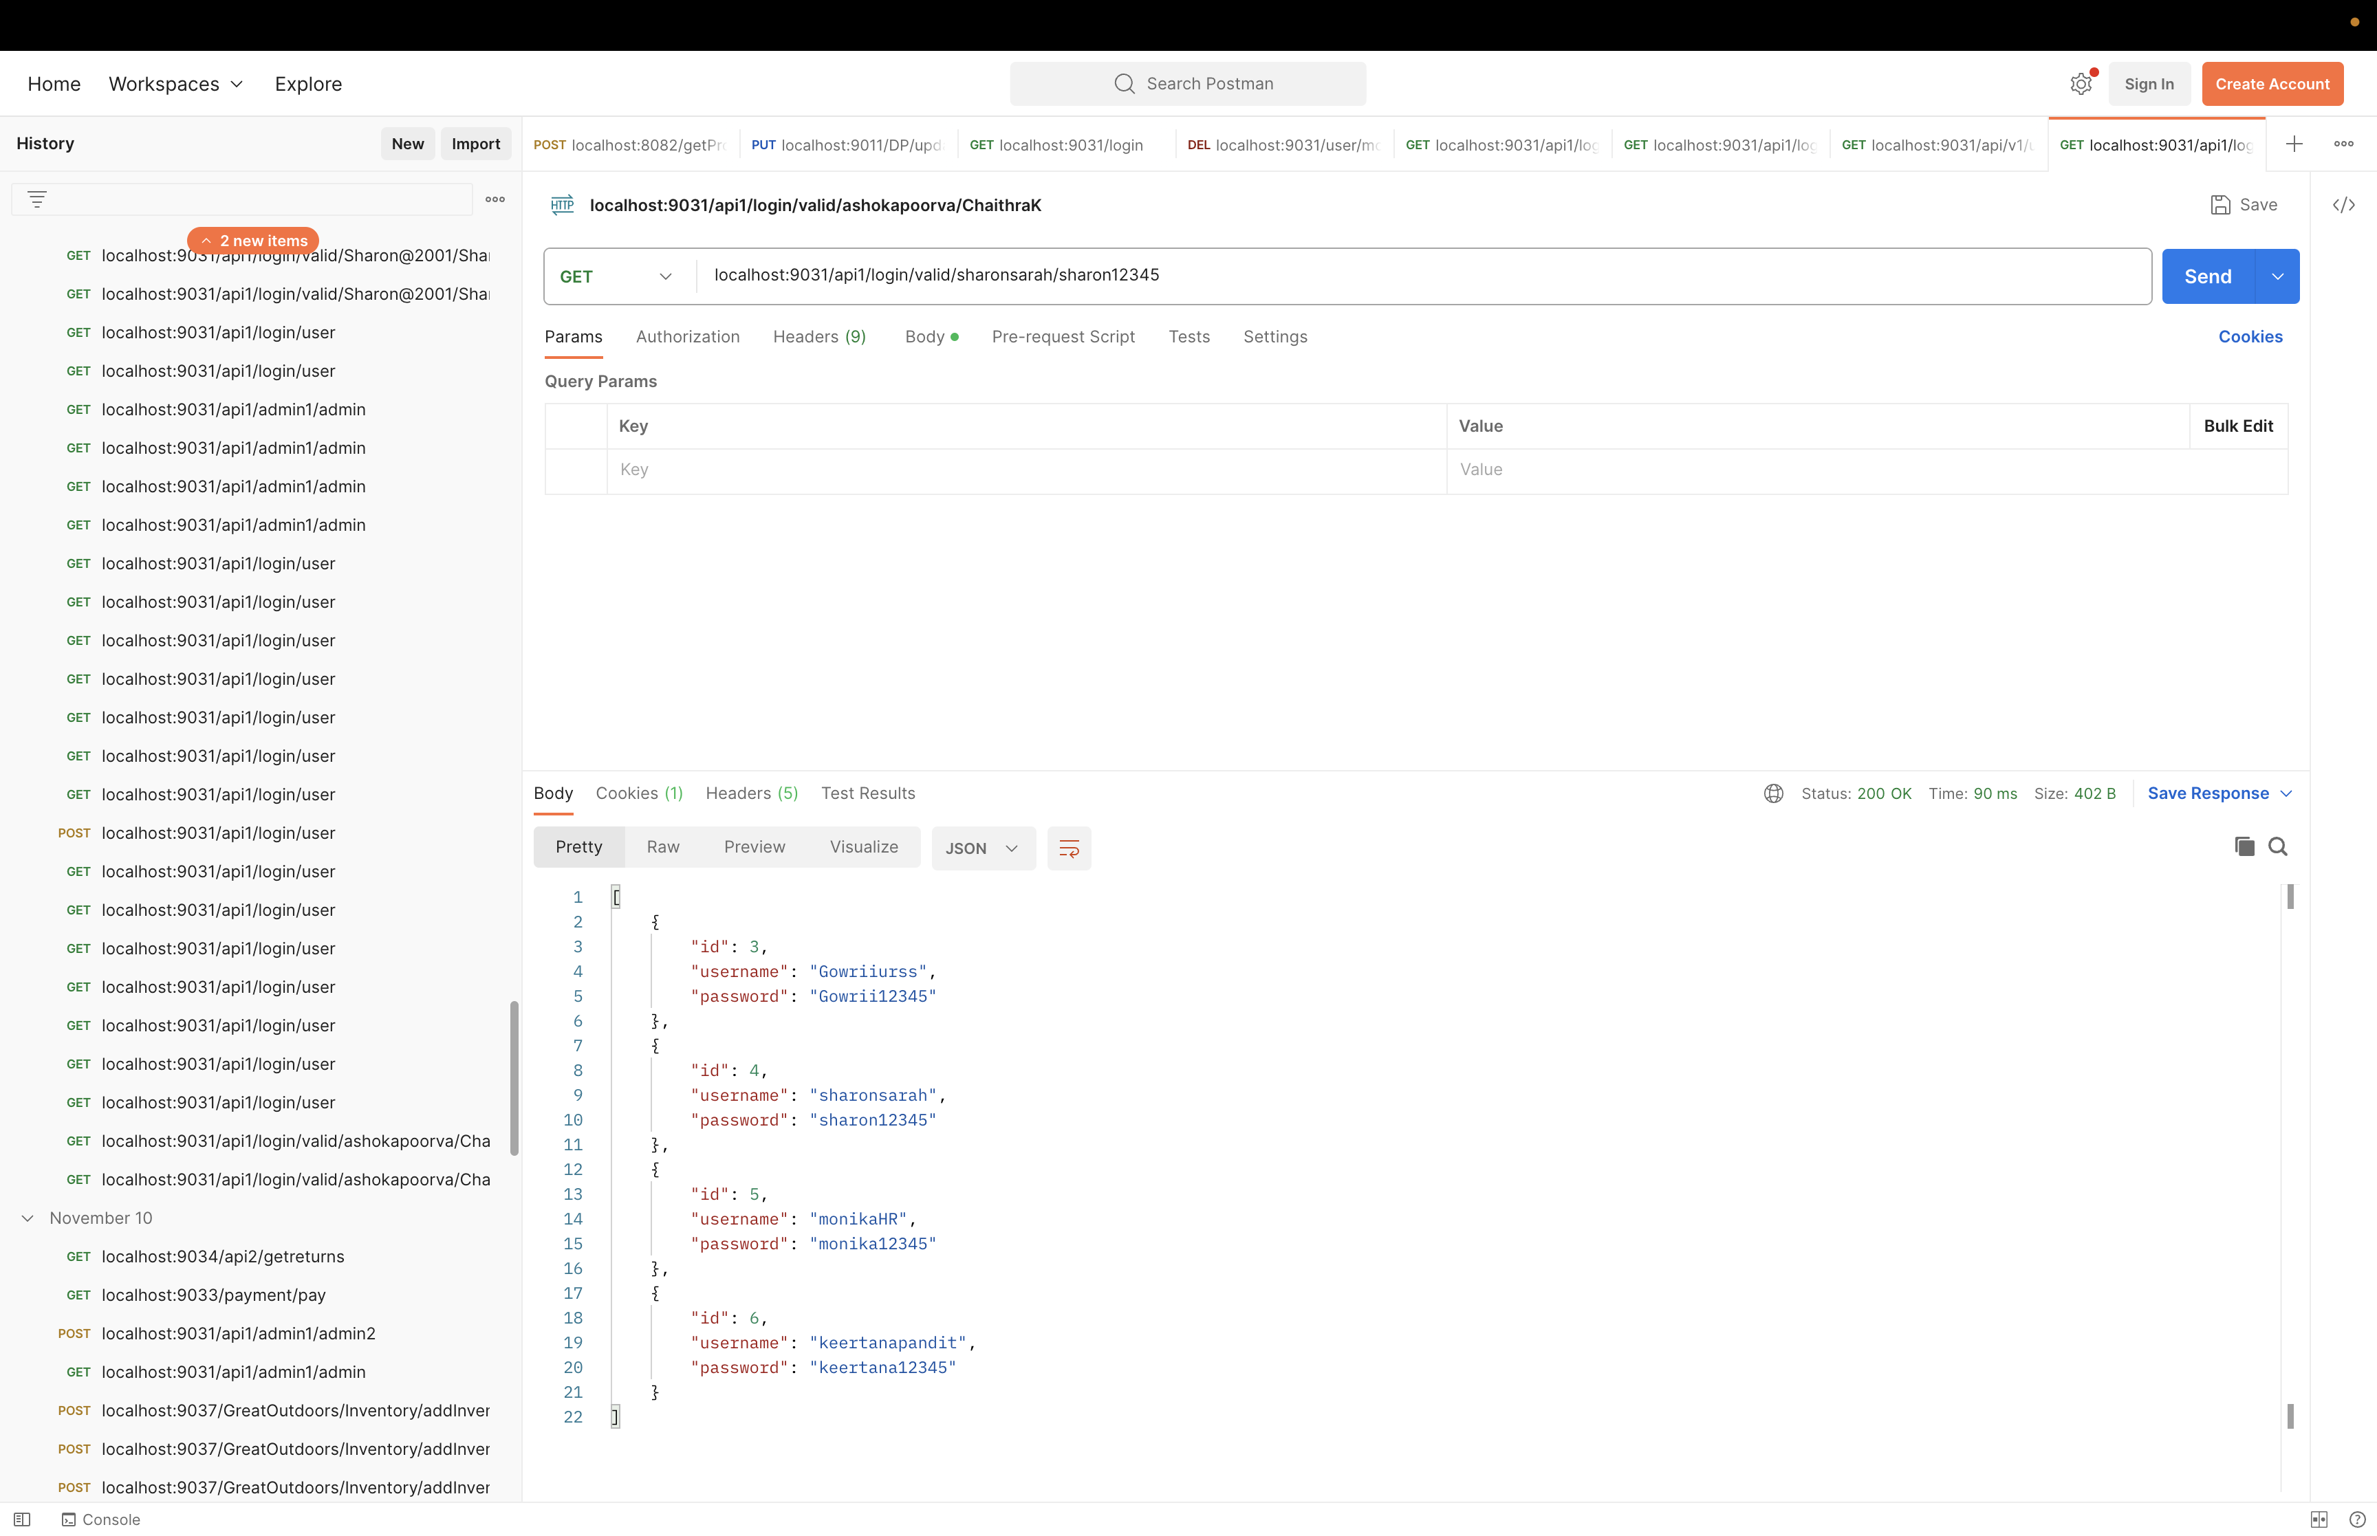
“
Authentication-Valid

Slide 7
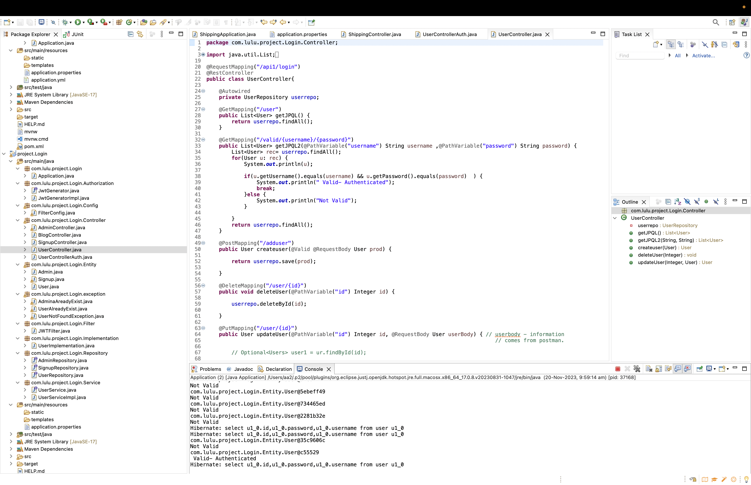
“
Authentication-Valid

Slide 8
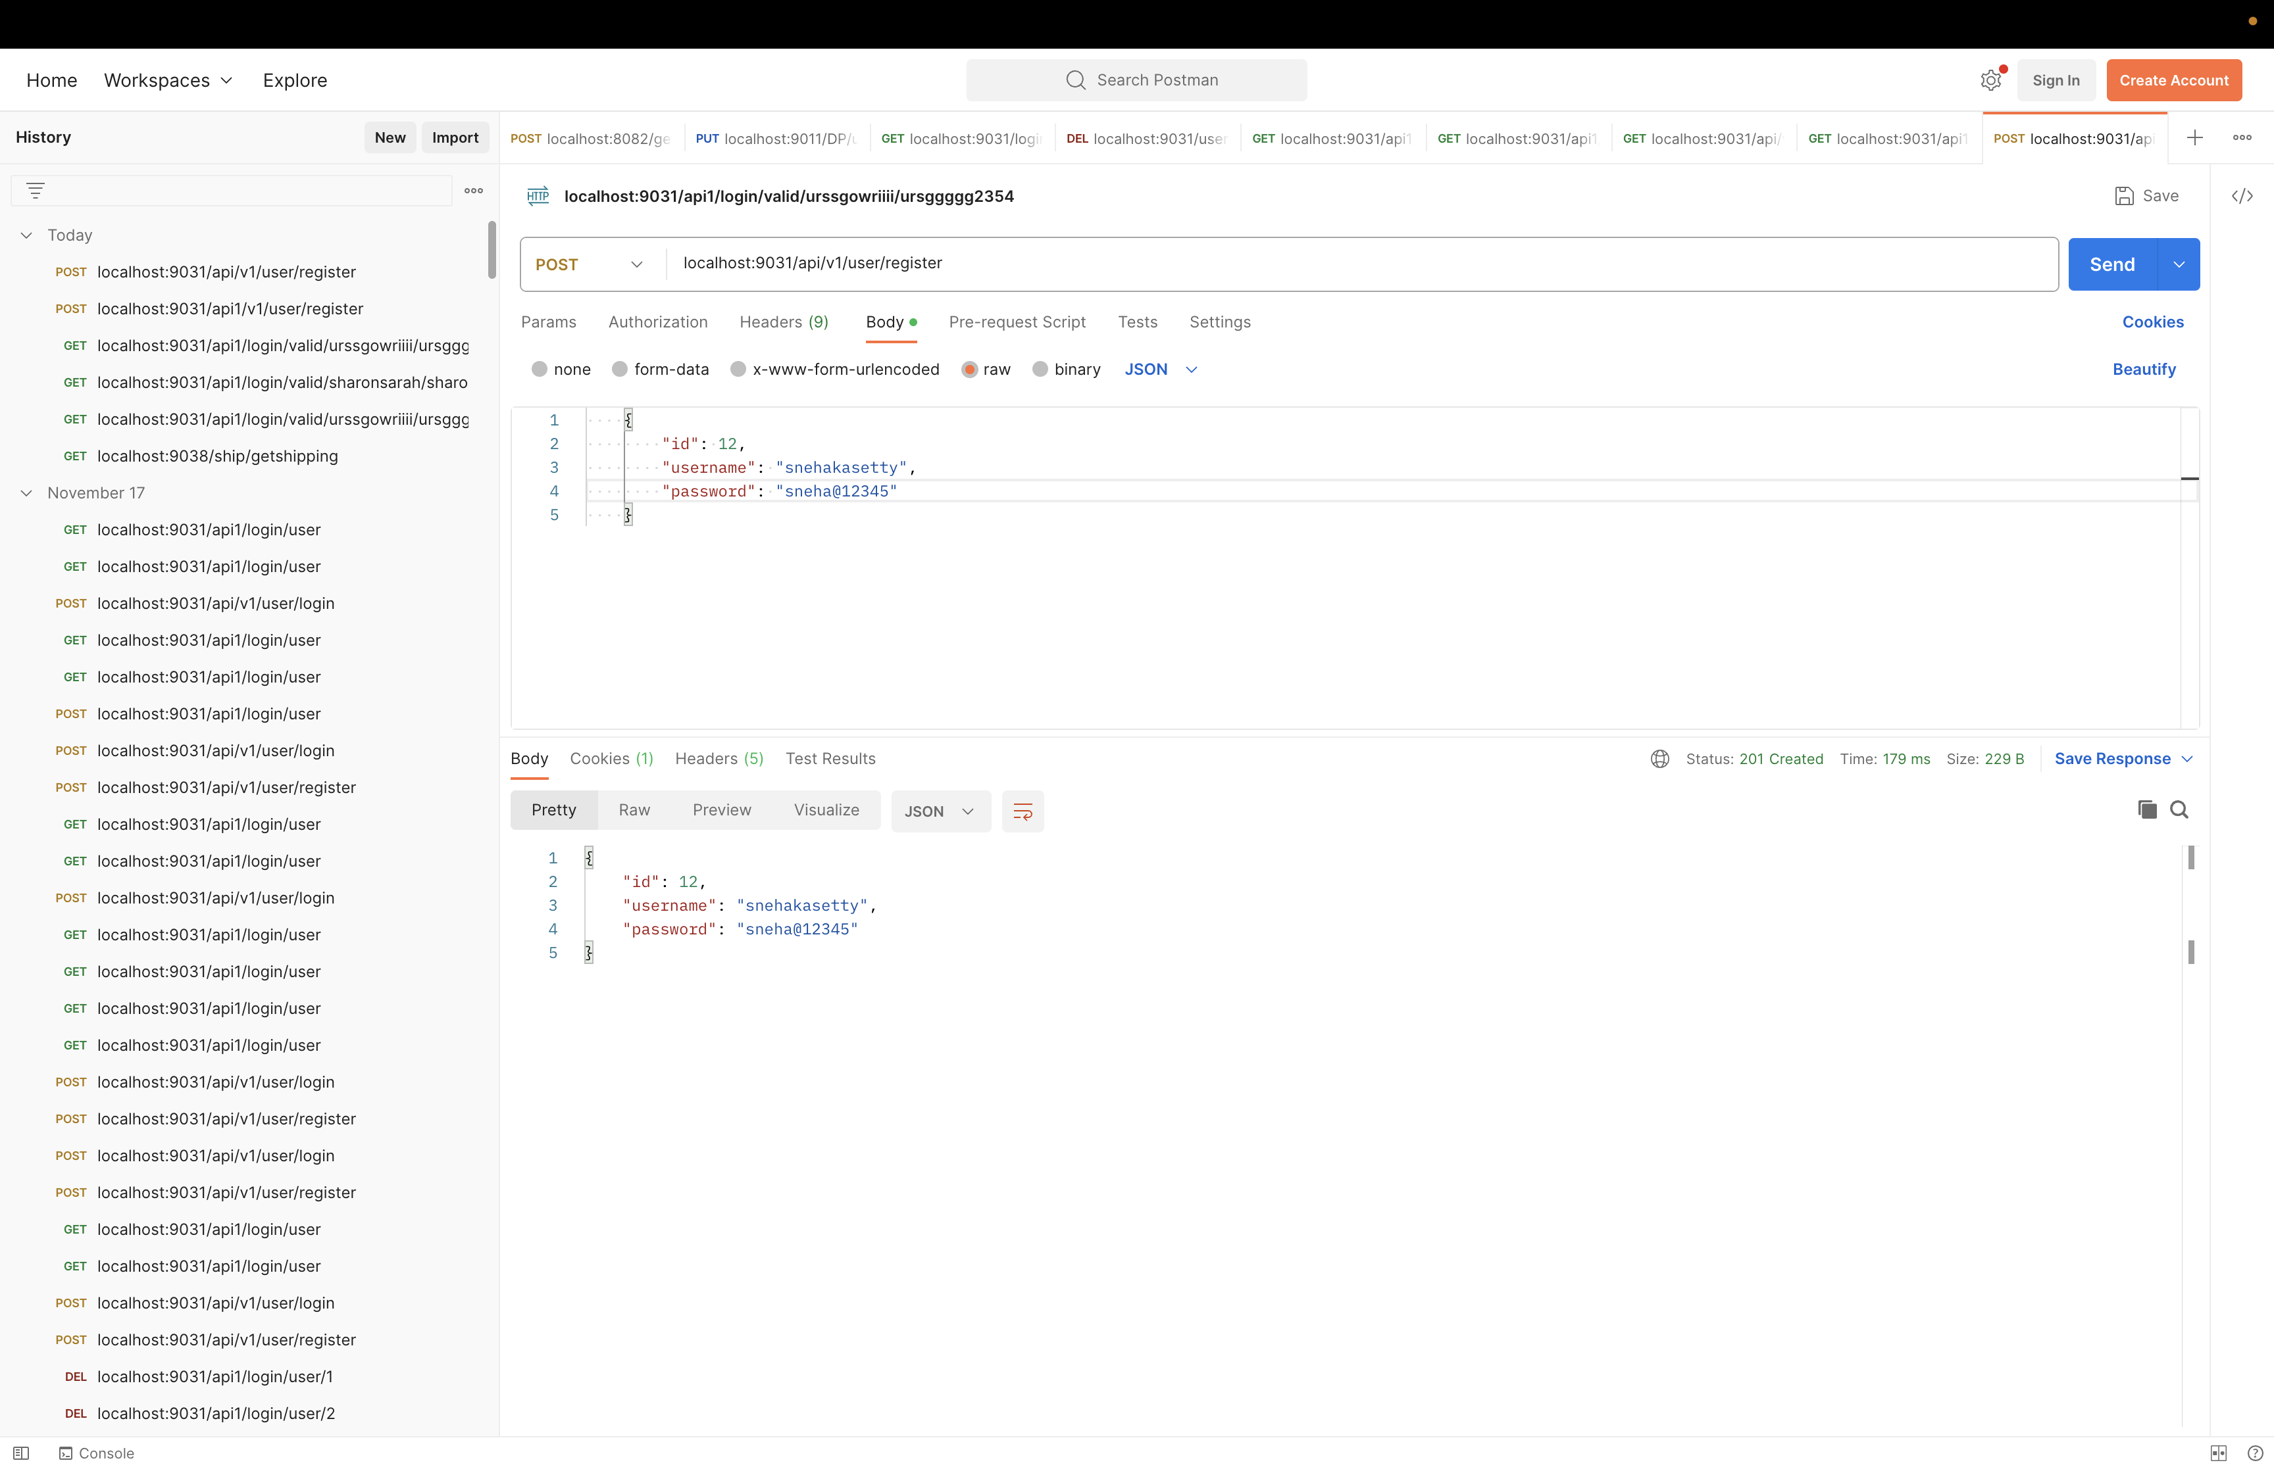
“
Authorization-User Registration

Slide 9
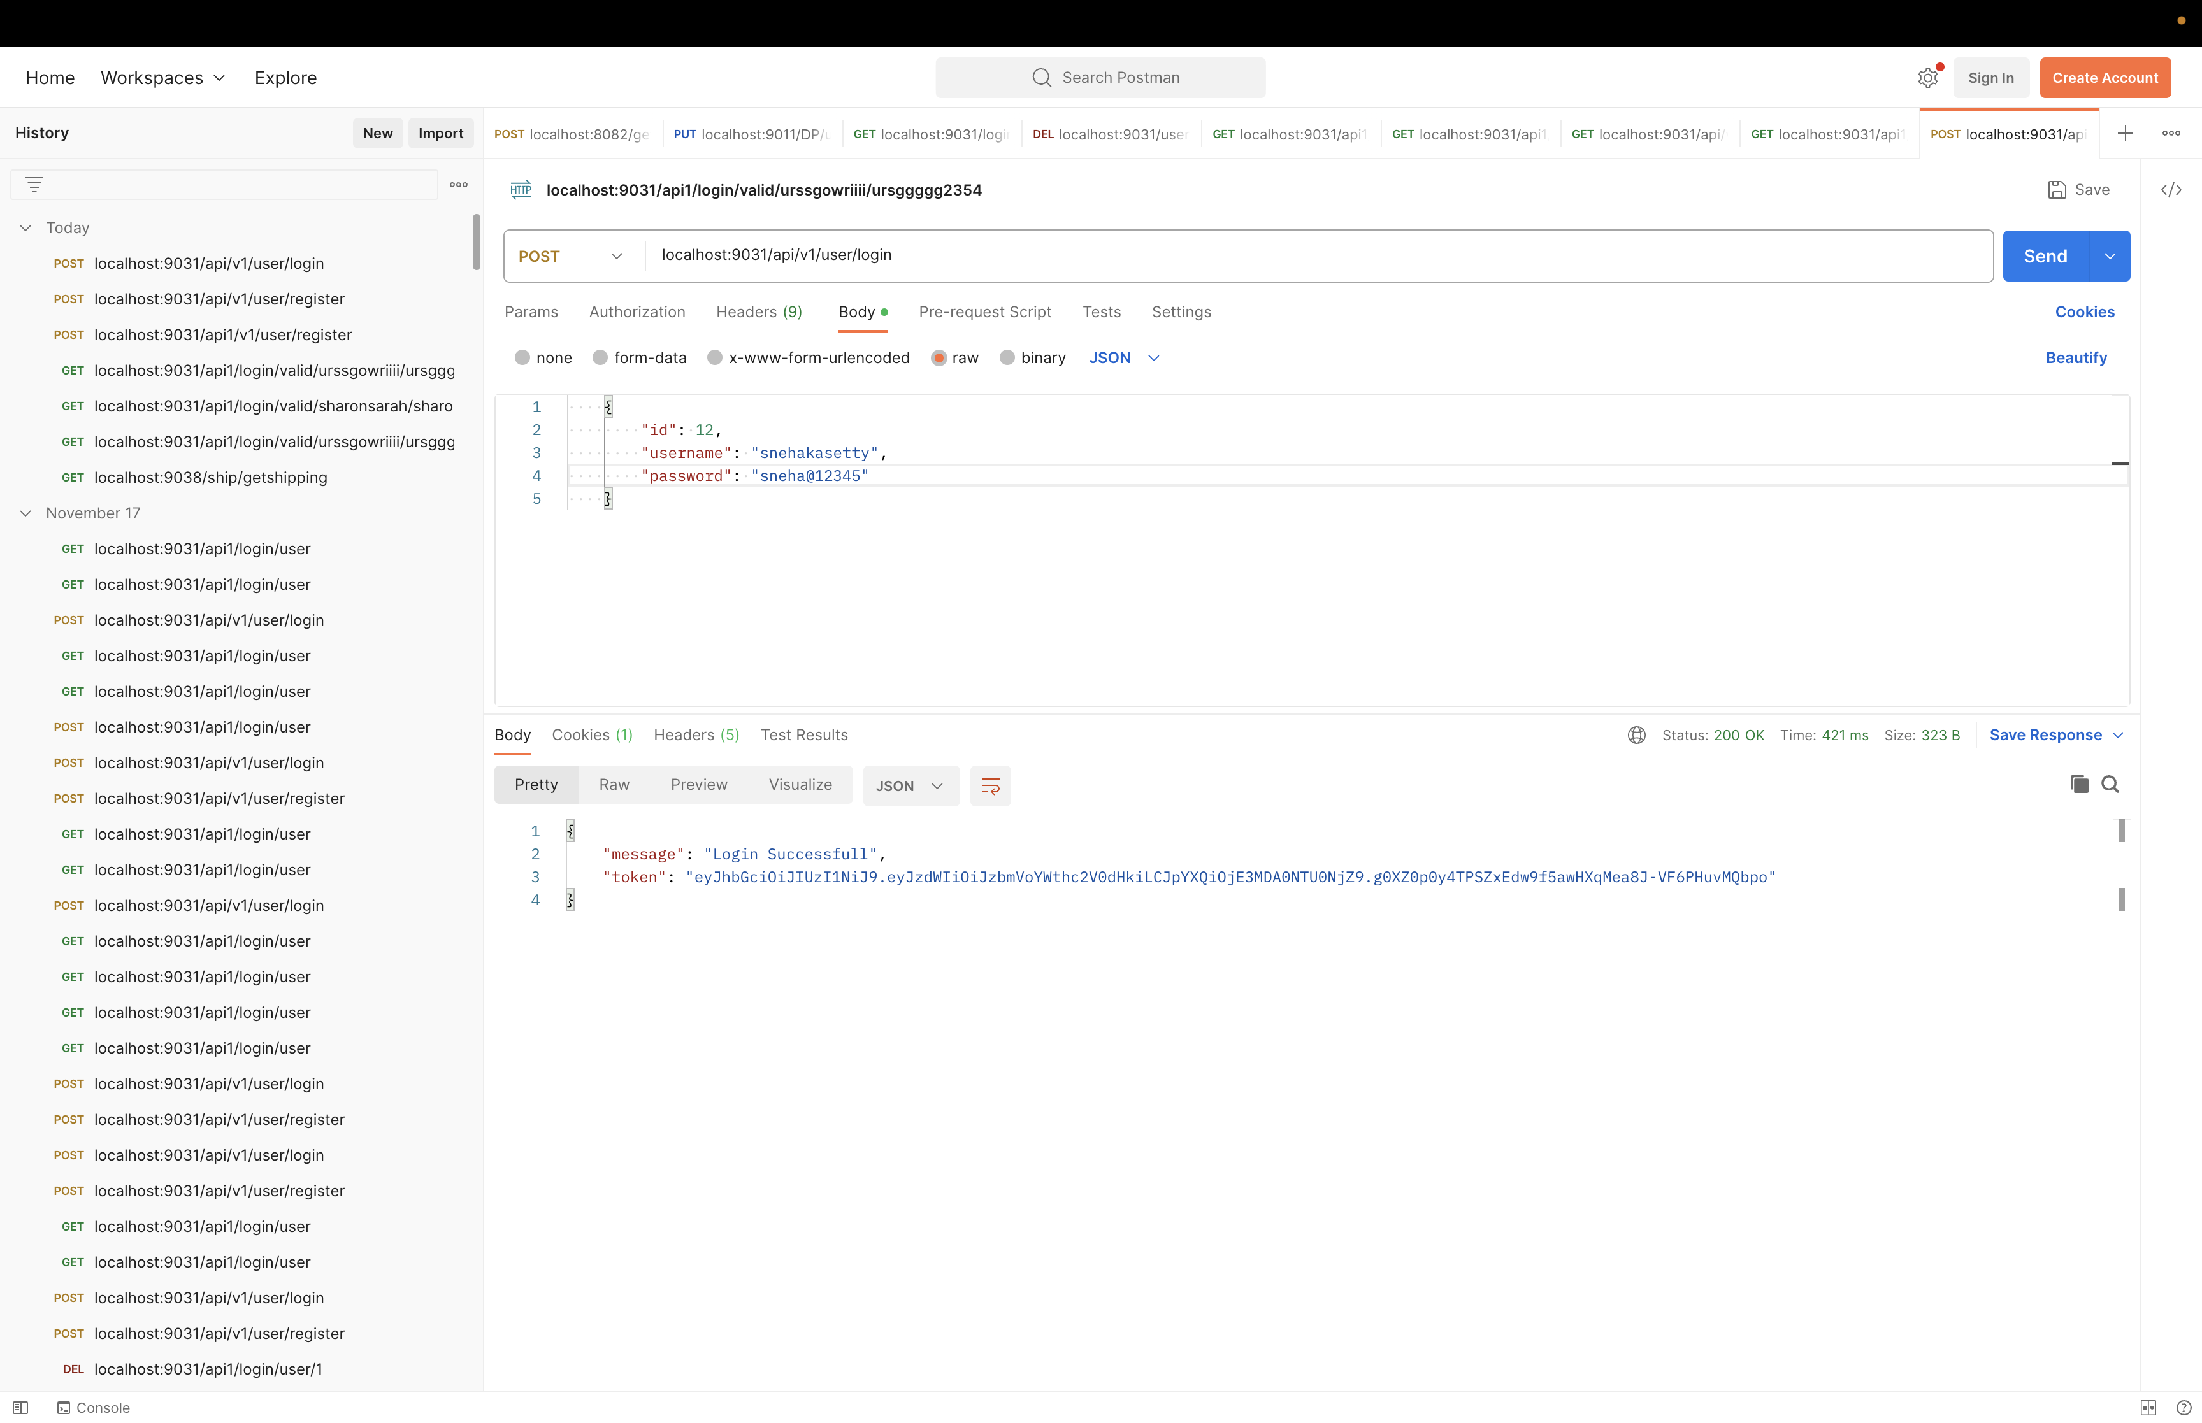
“
Authorization-Token generation User

Slide 10
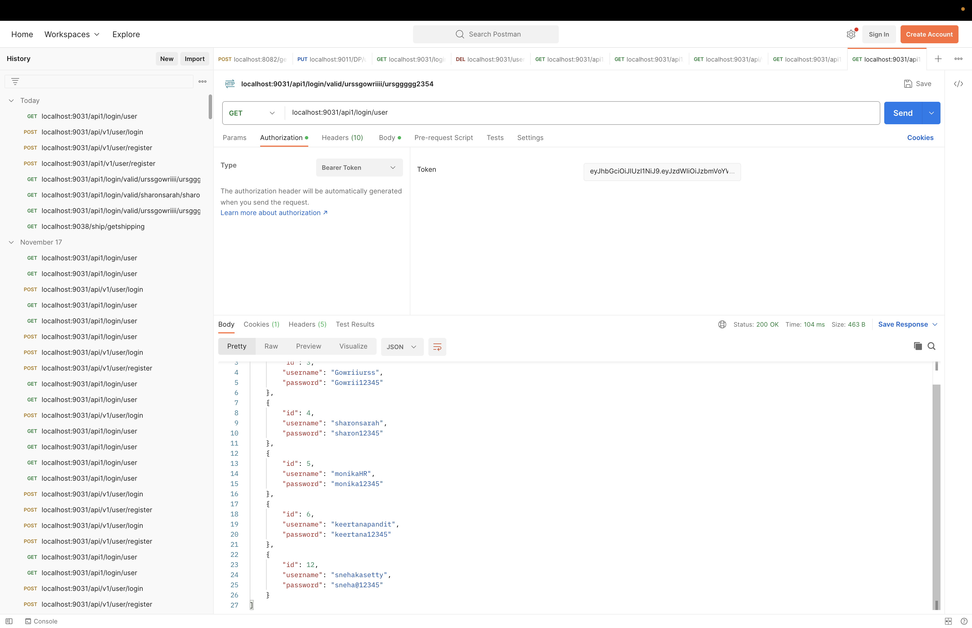
“
Authorization- Correct Token

Slide 11
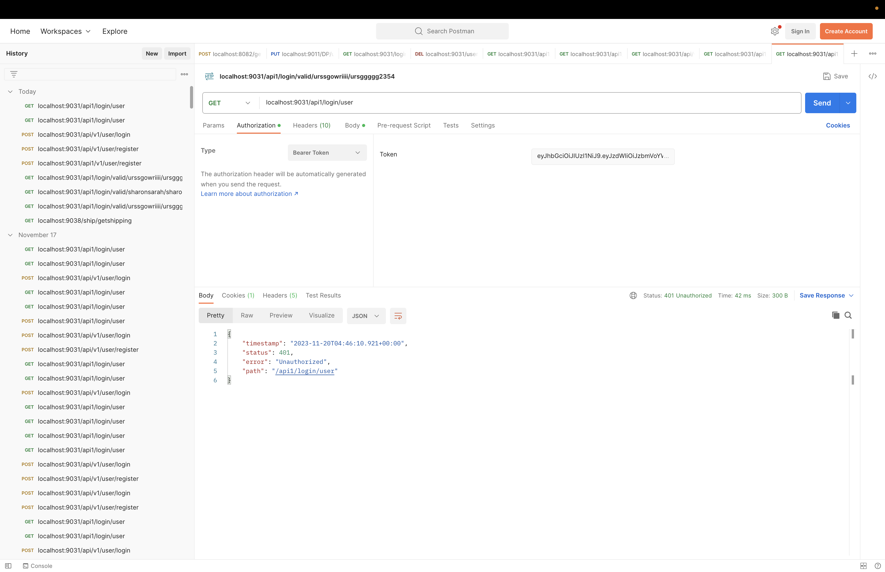
“
Authorization- Invalid Token

Slide 12
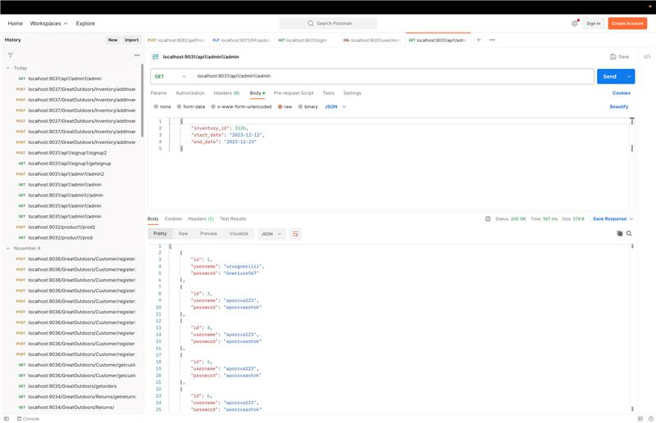
“
Admin

Slide 13
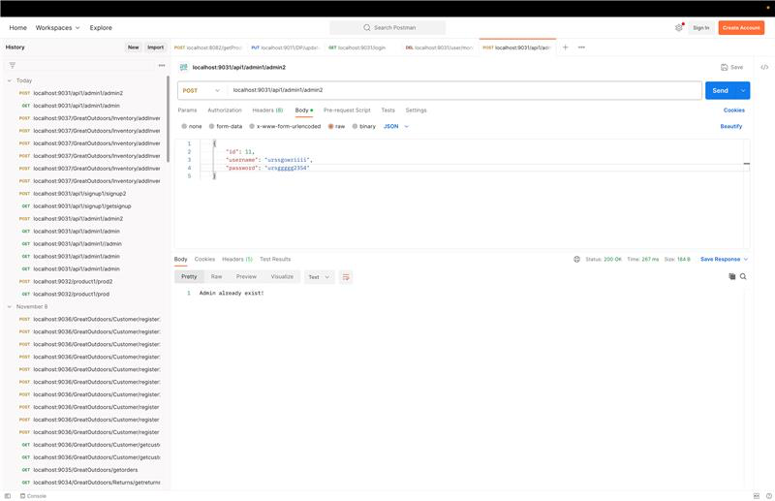
“

Slide 14
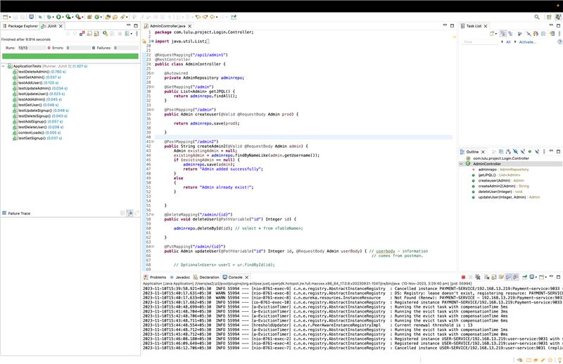
“

Slide 15
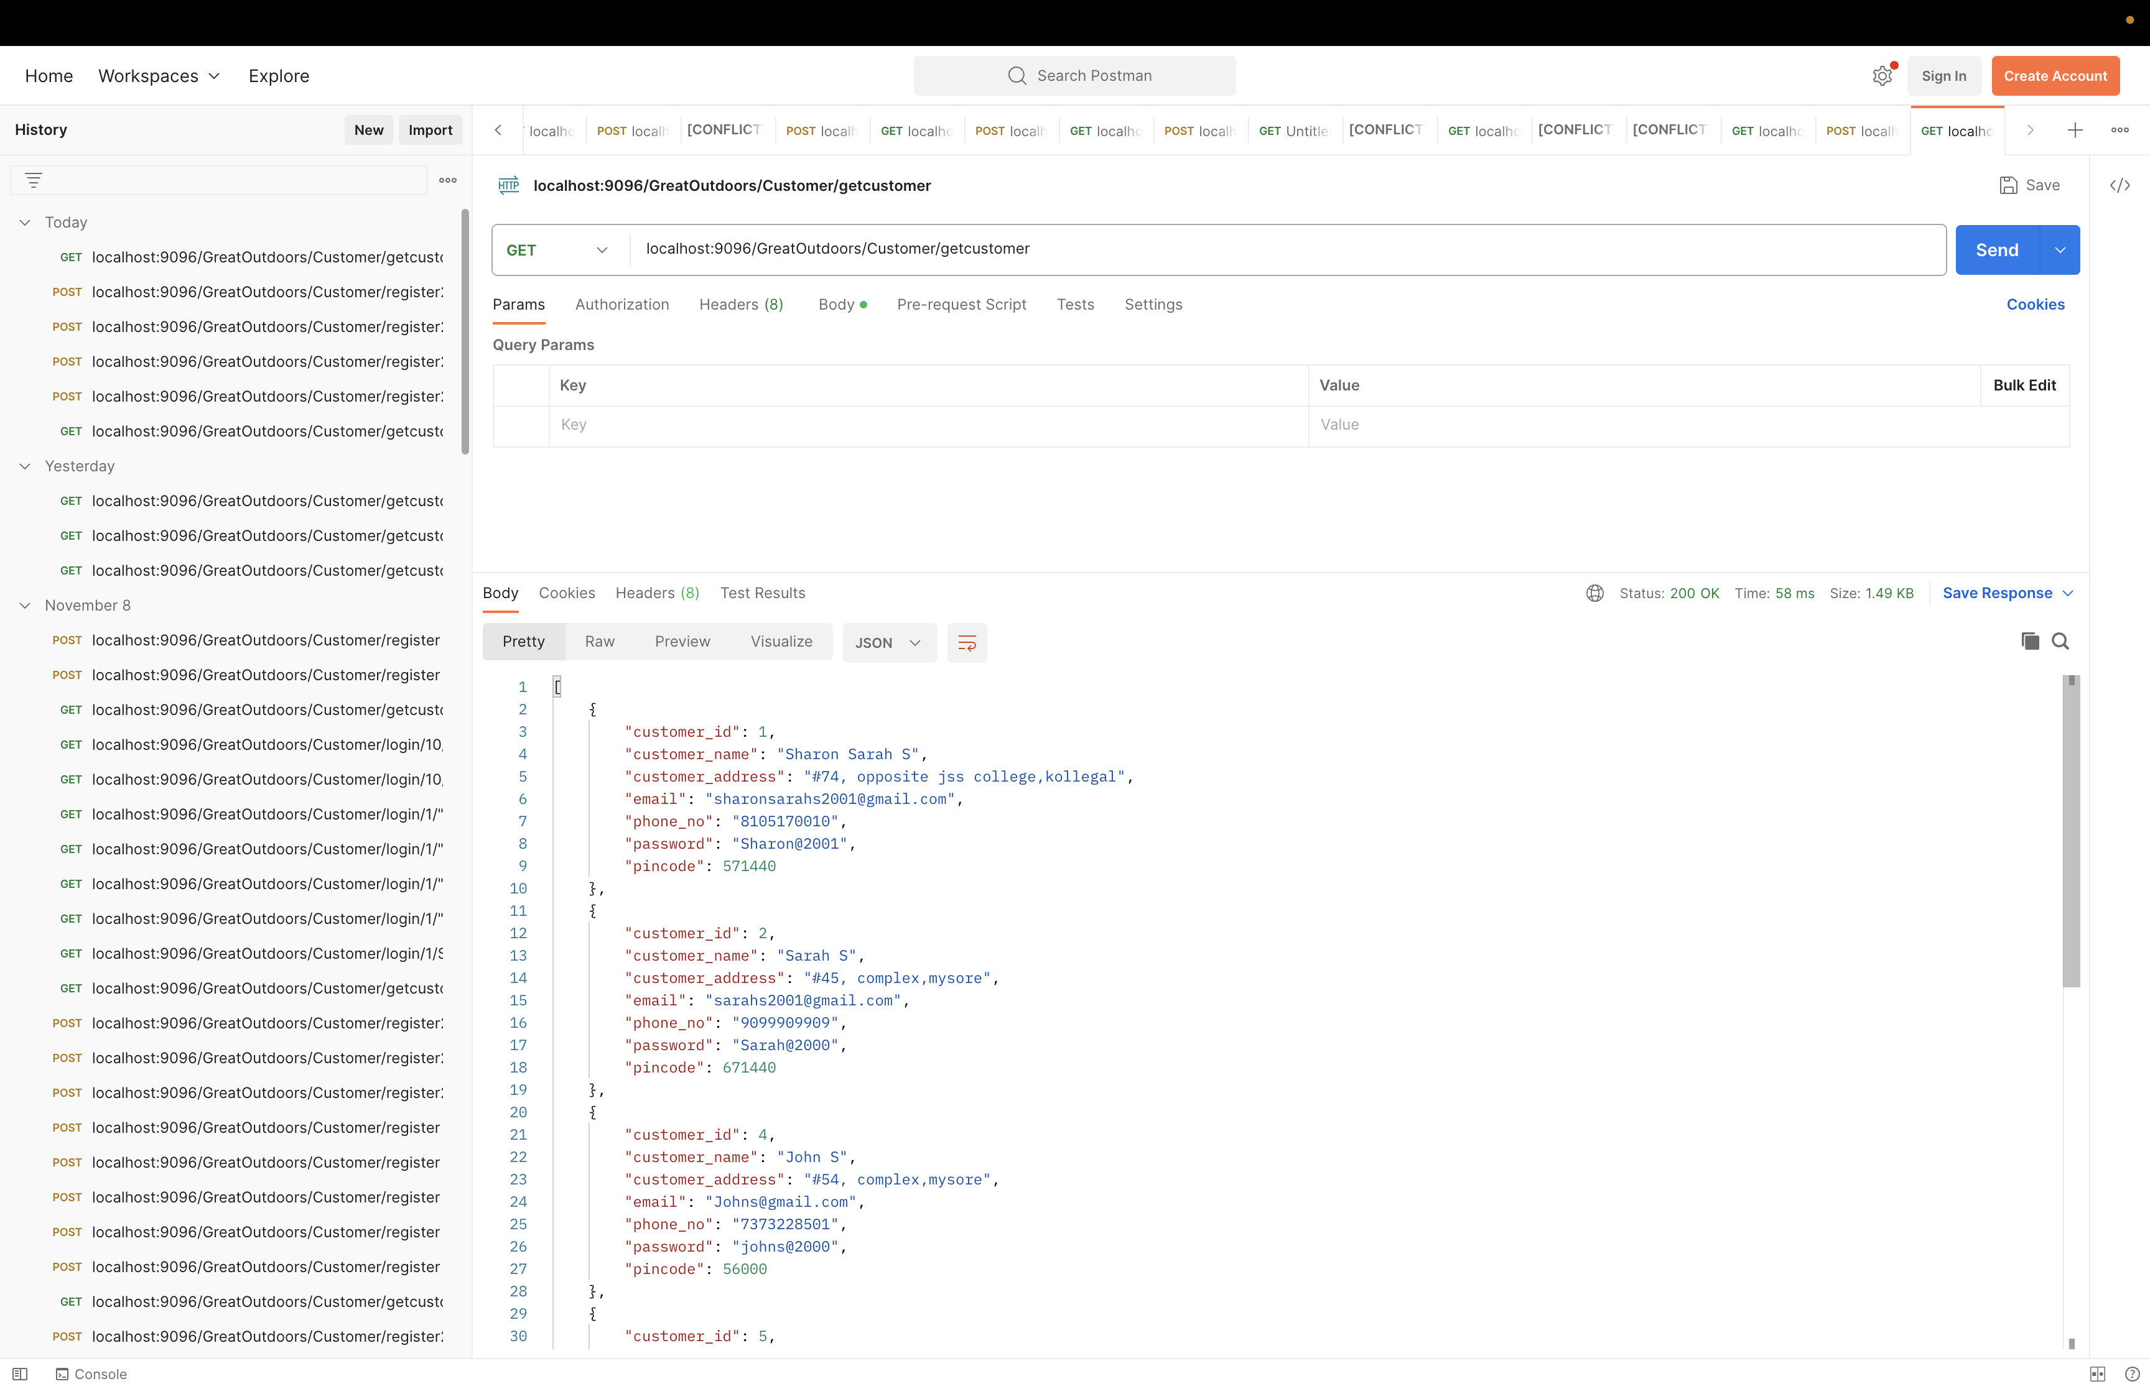
Customer

Slide 16
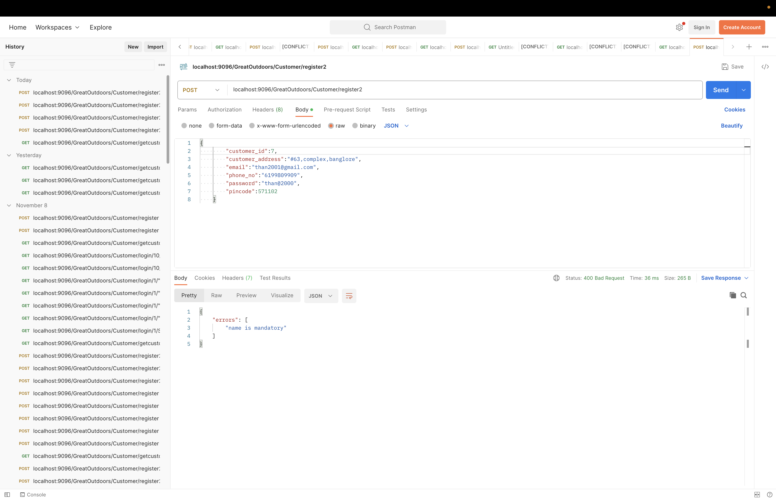
“

Slide 17
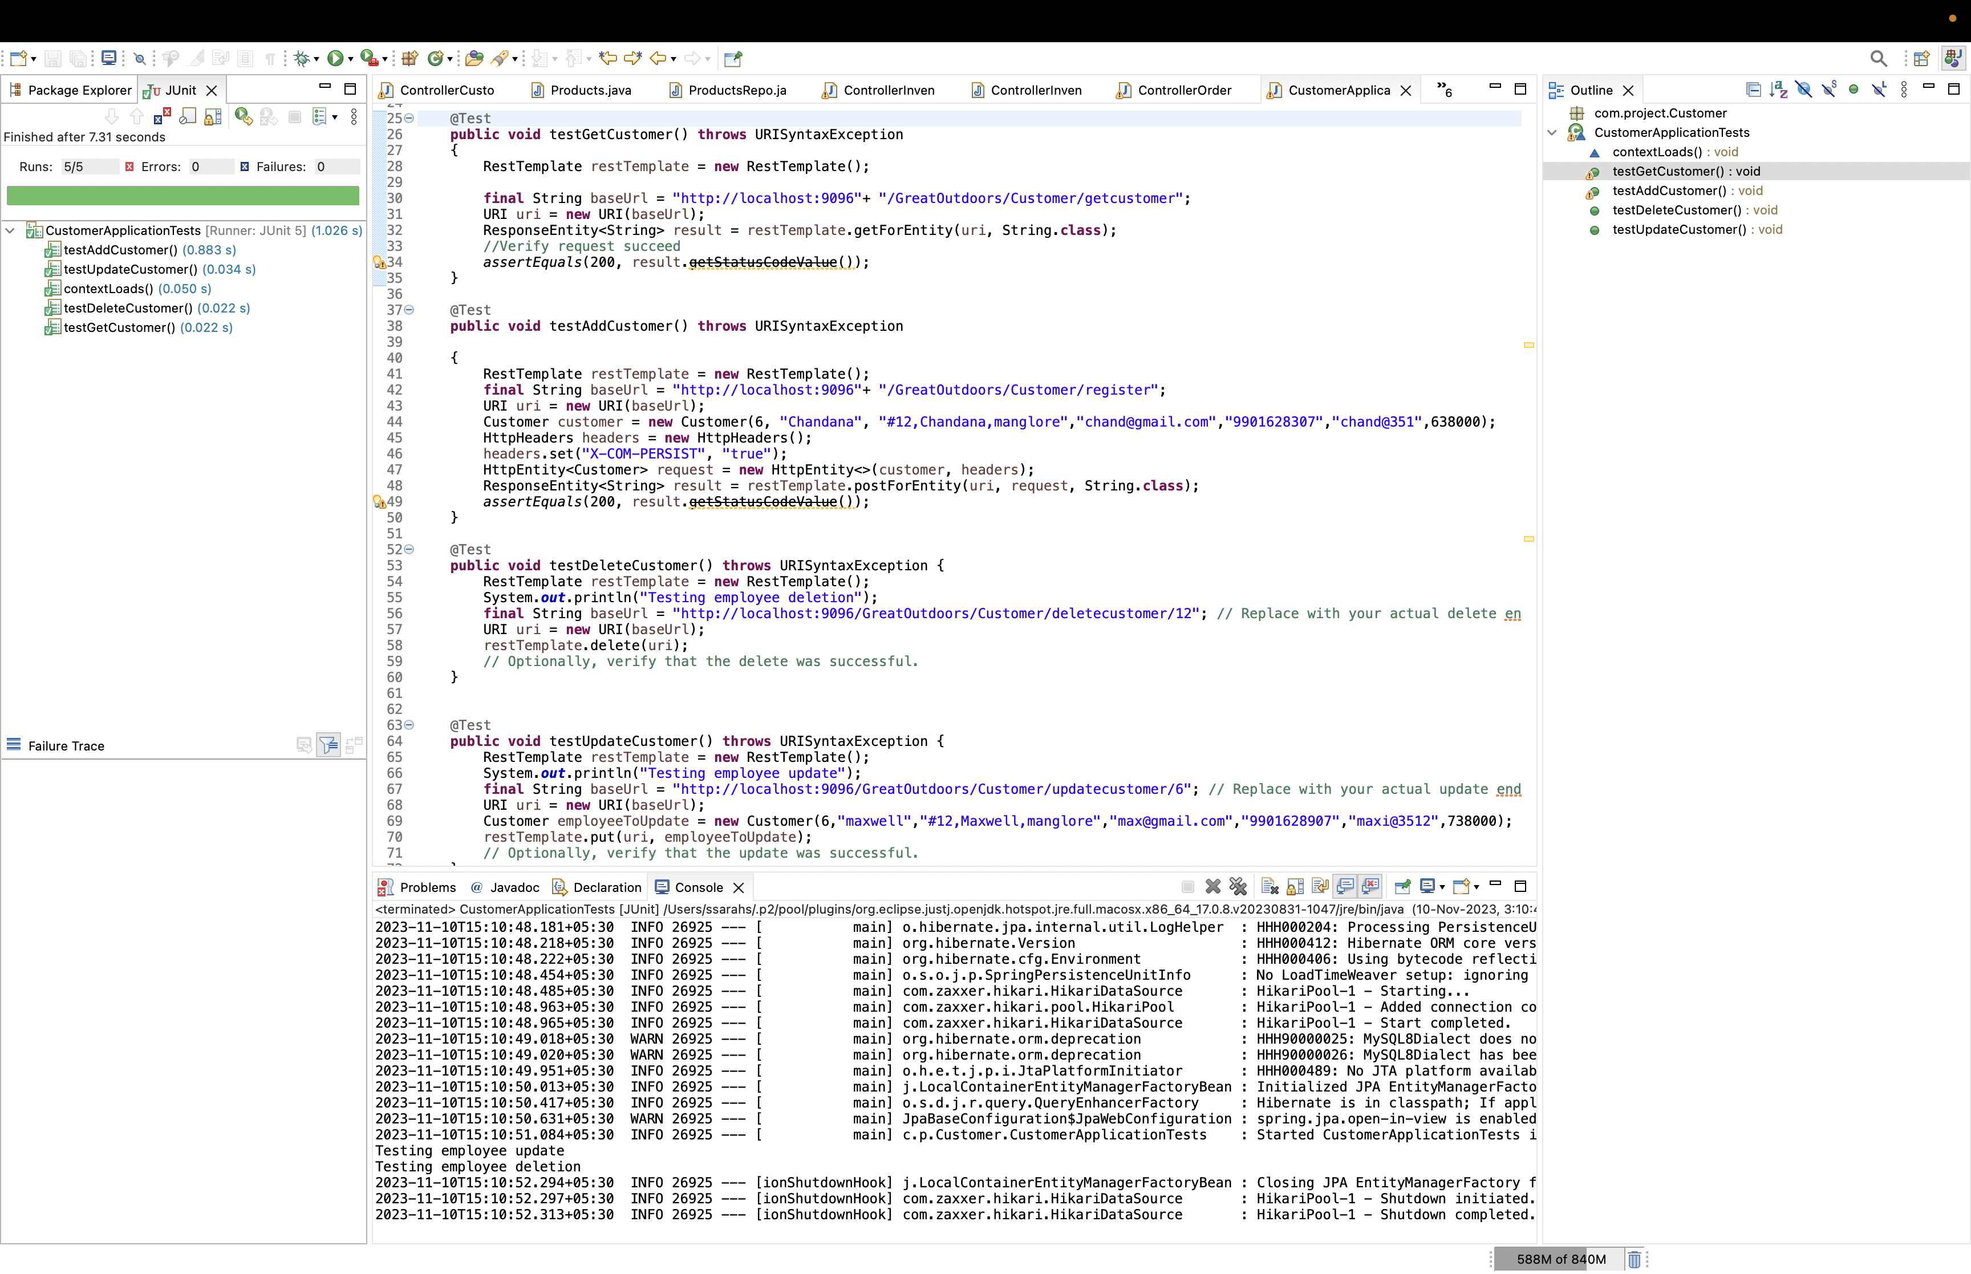
“

Slide 18
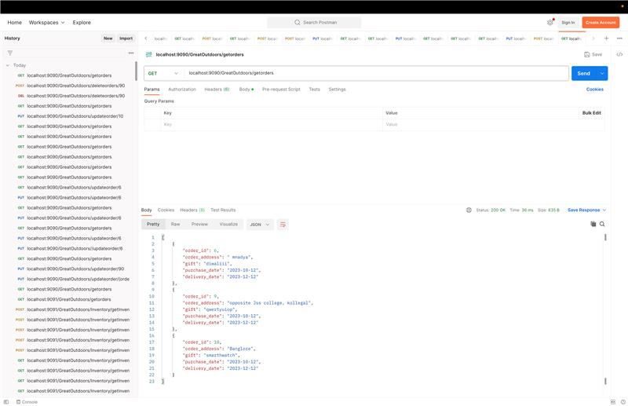
Order

Slide 19
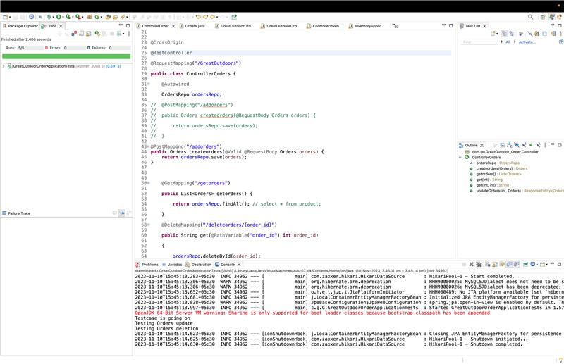

Slide 20
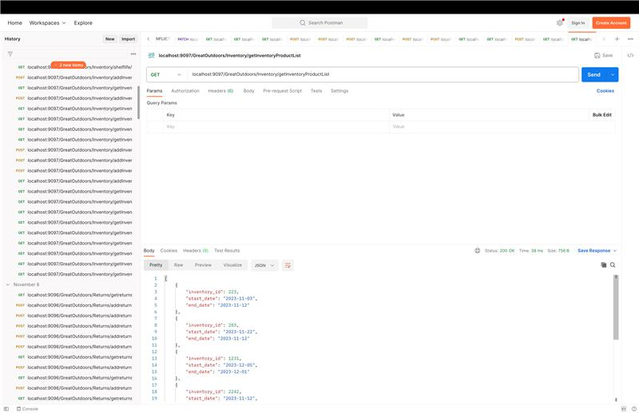
“
Inventory

Slide 21
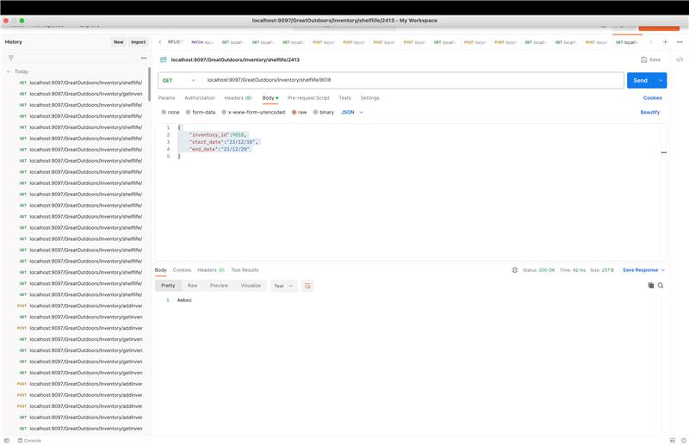
“

Slide 22
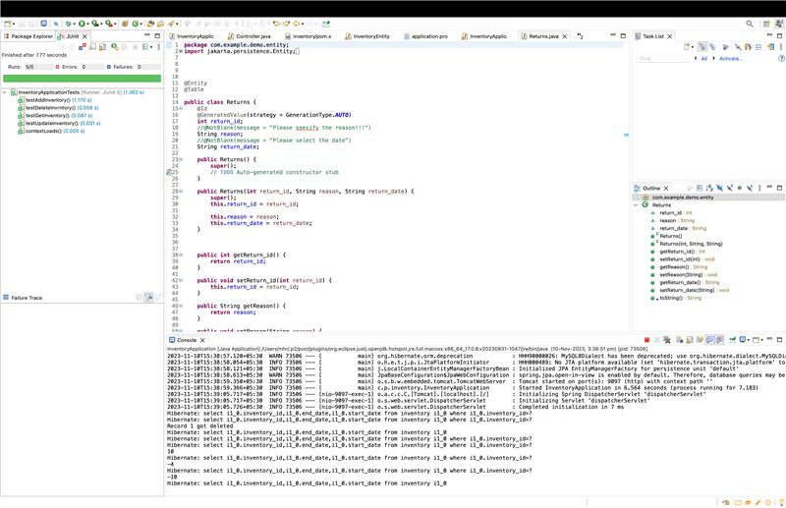
“

Slide 23
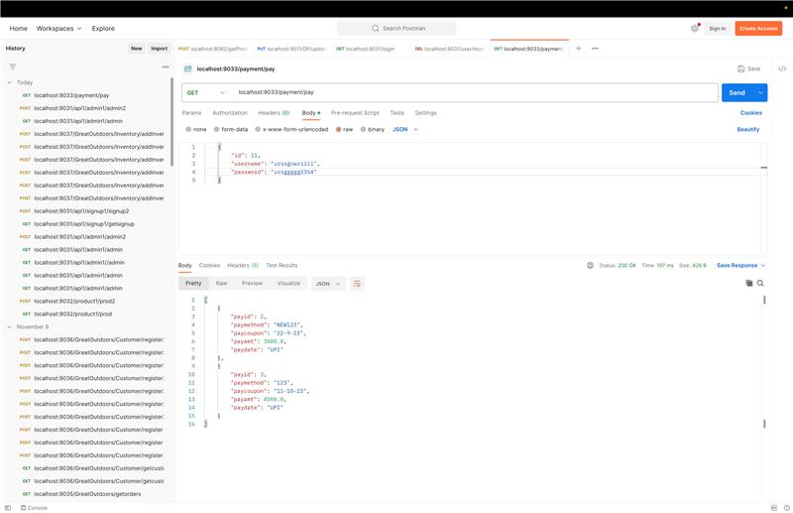
Payment

Slide 24
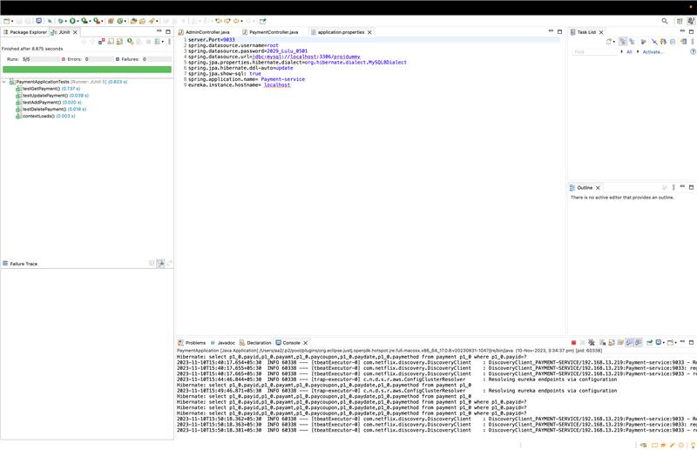

Slide 25
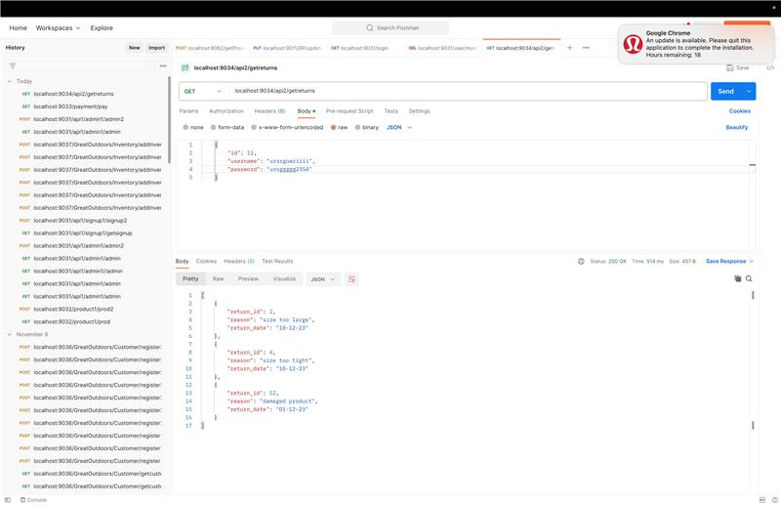
Returns

Slide 26
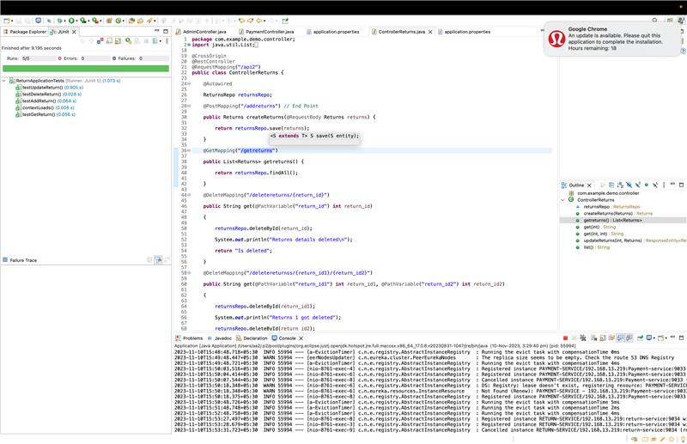

Slide 27
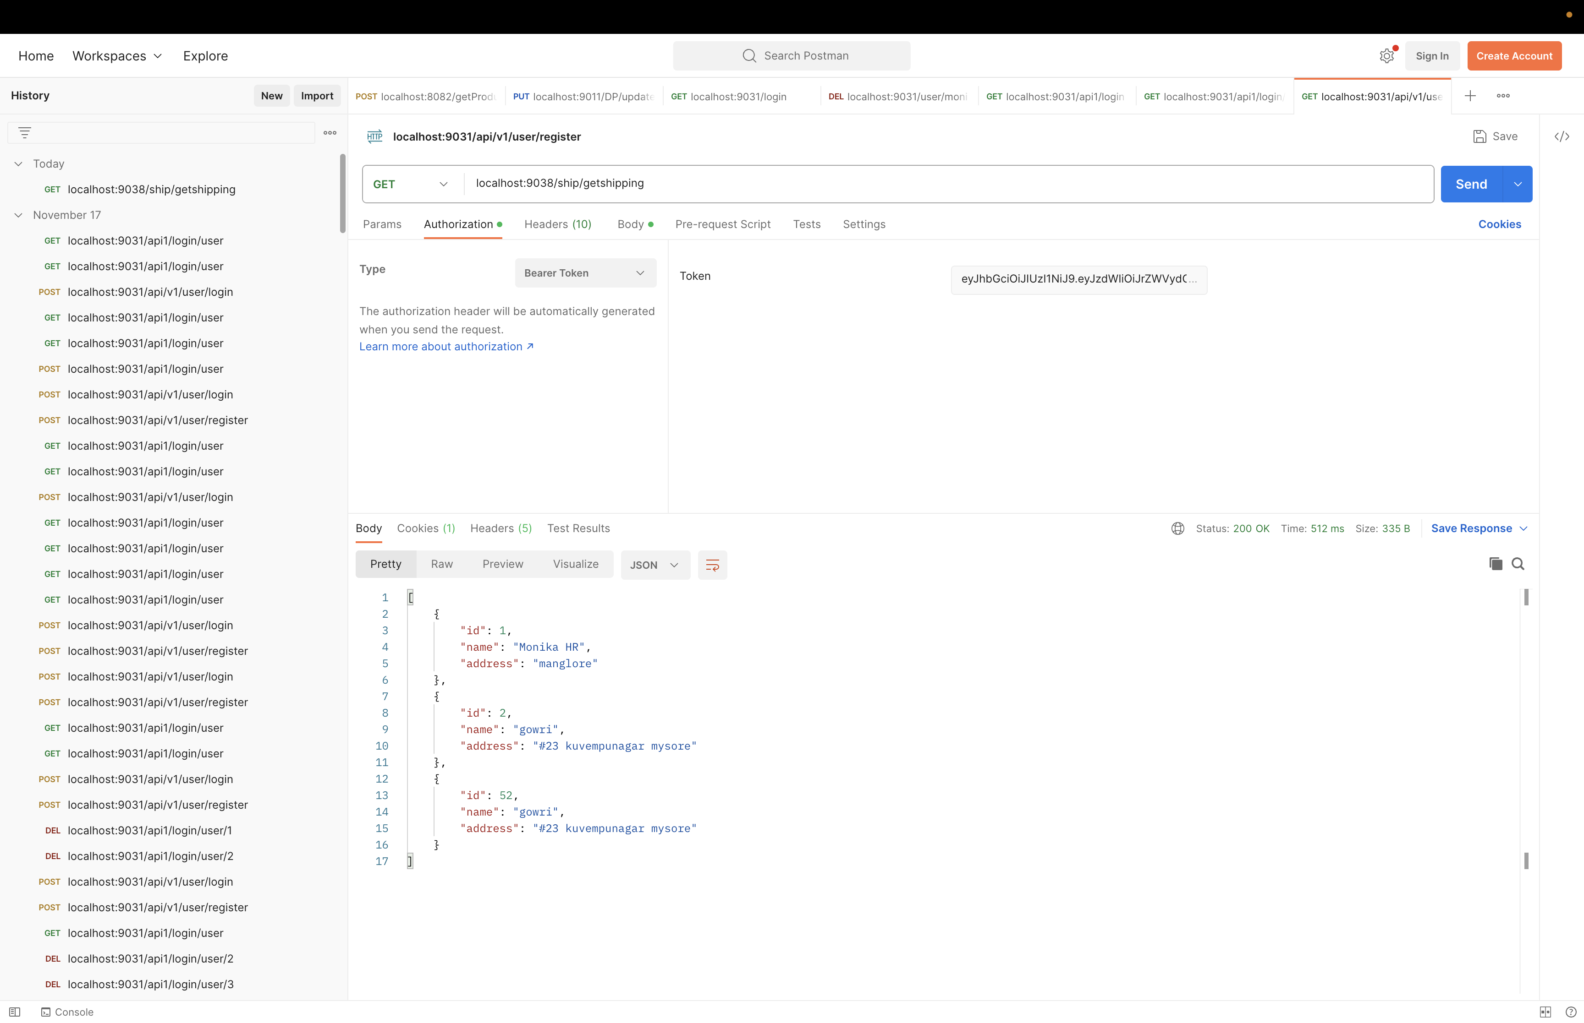
Shipping

Slide 28
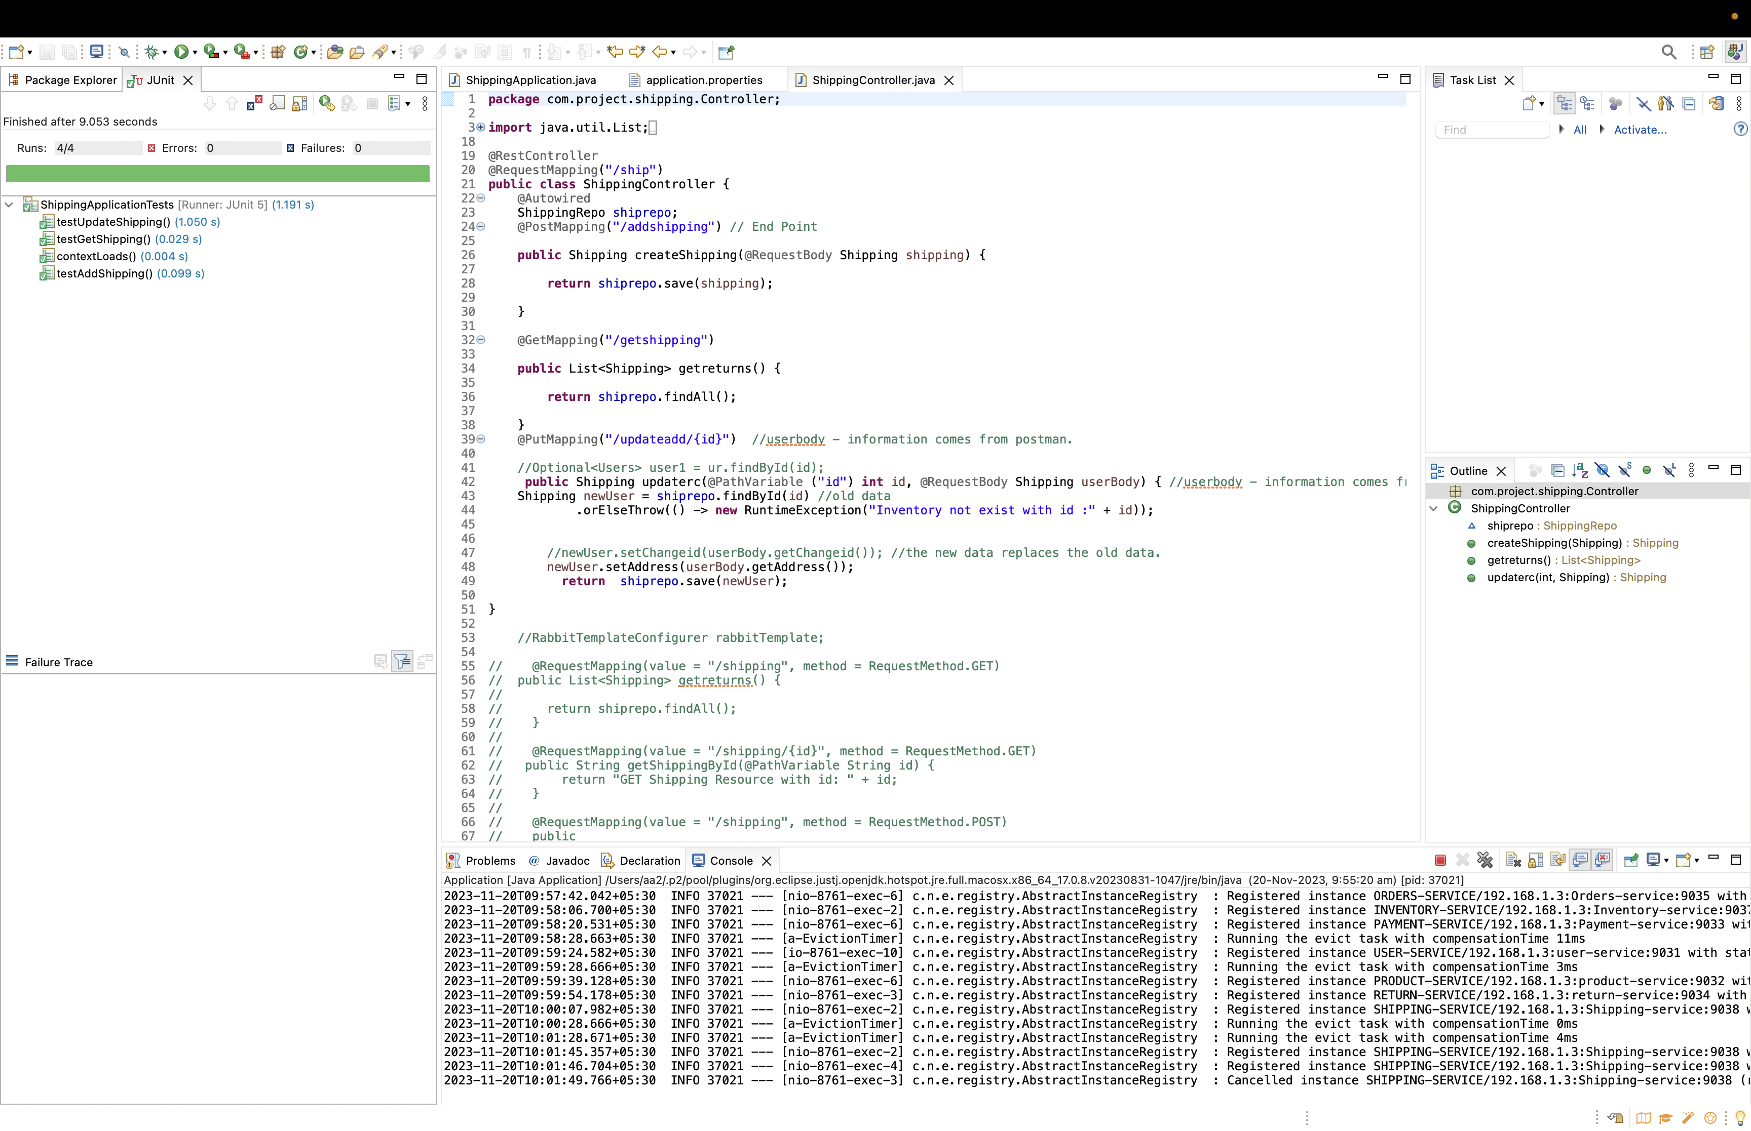

Slide 29
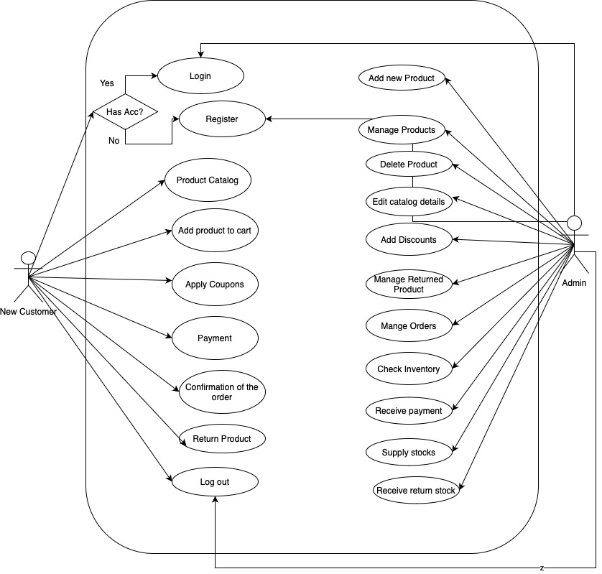
Use Case Diagram

Slide 30
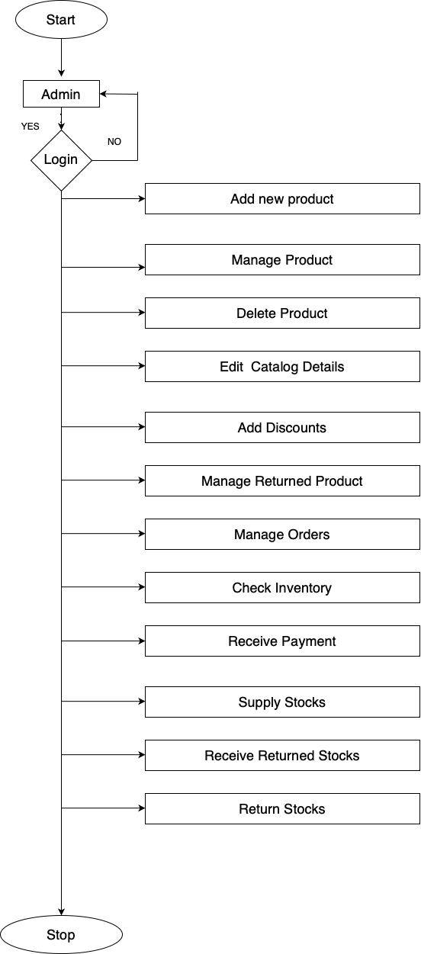
“
Admin Flow Chart

Slide 31
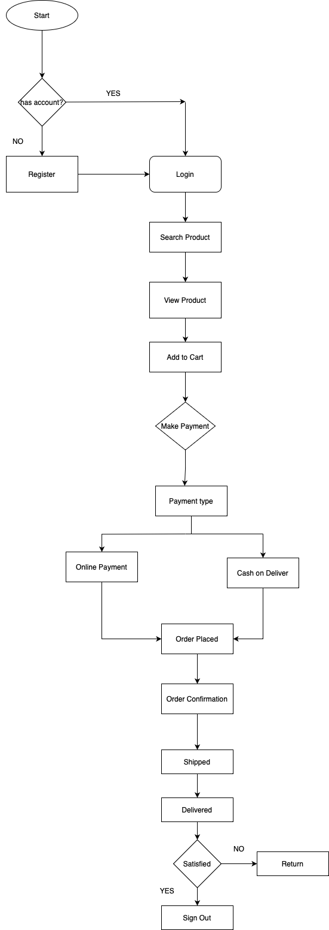
“
User Flow Chart

Slide 32
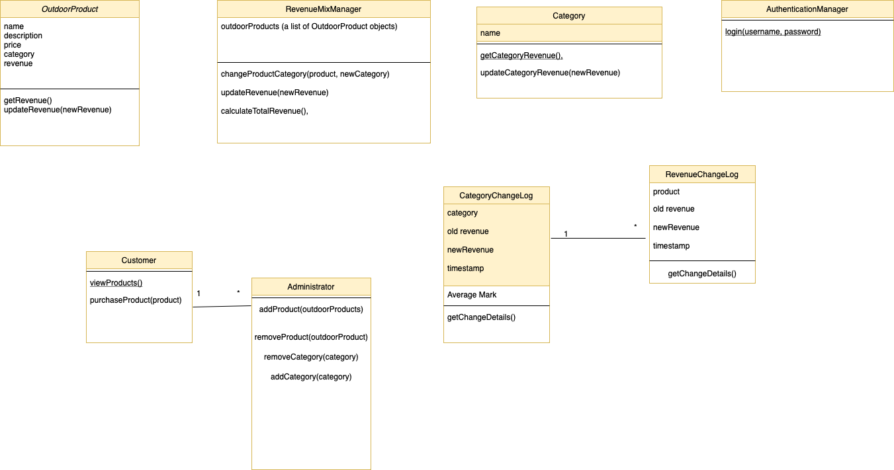
Class Diagram - Change Revenue mix

Slide 33
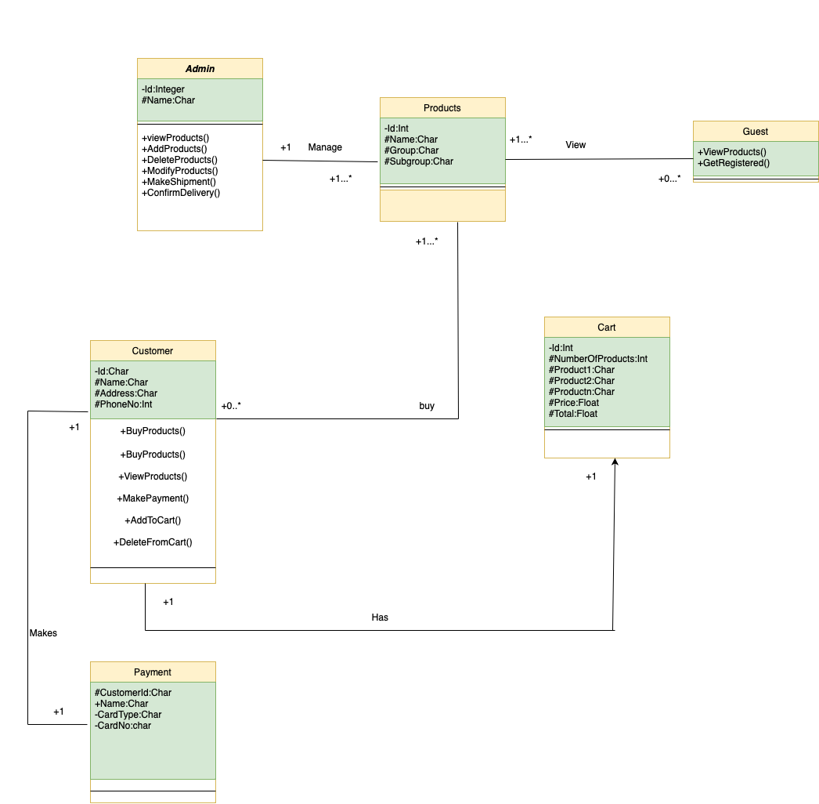
Class Diagram – Order Management

Slide 34
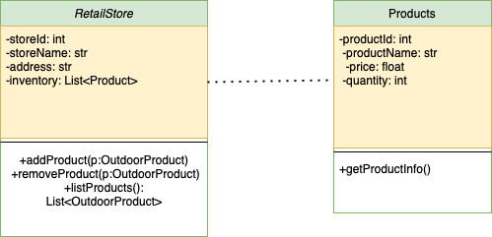
Class Diagram – Retail Store

Slide 35
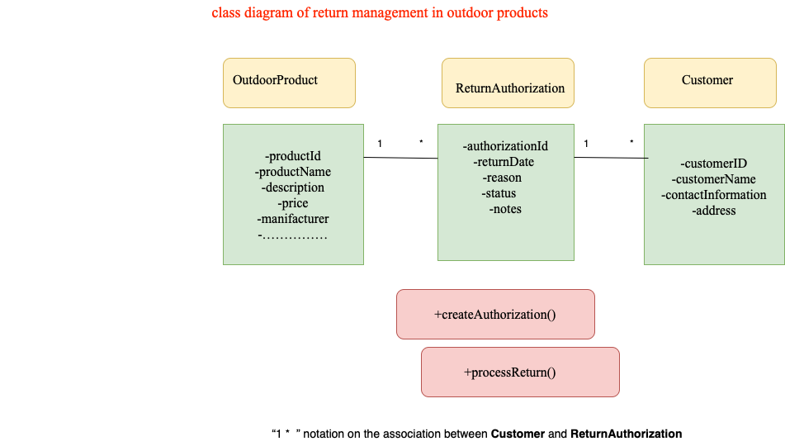
Class Diagram – Return Management

Slide 36
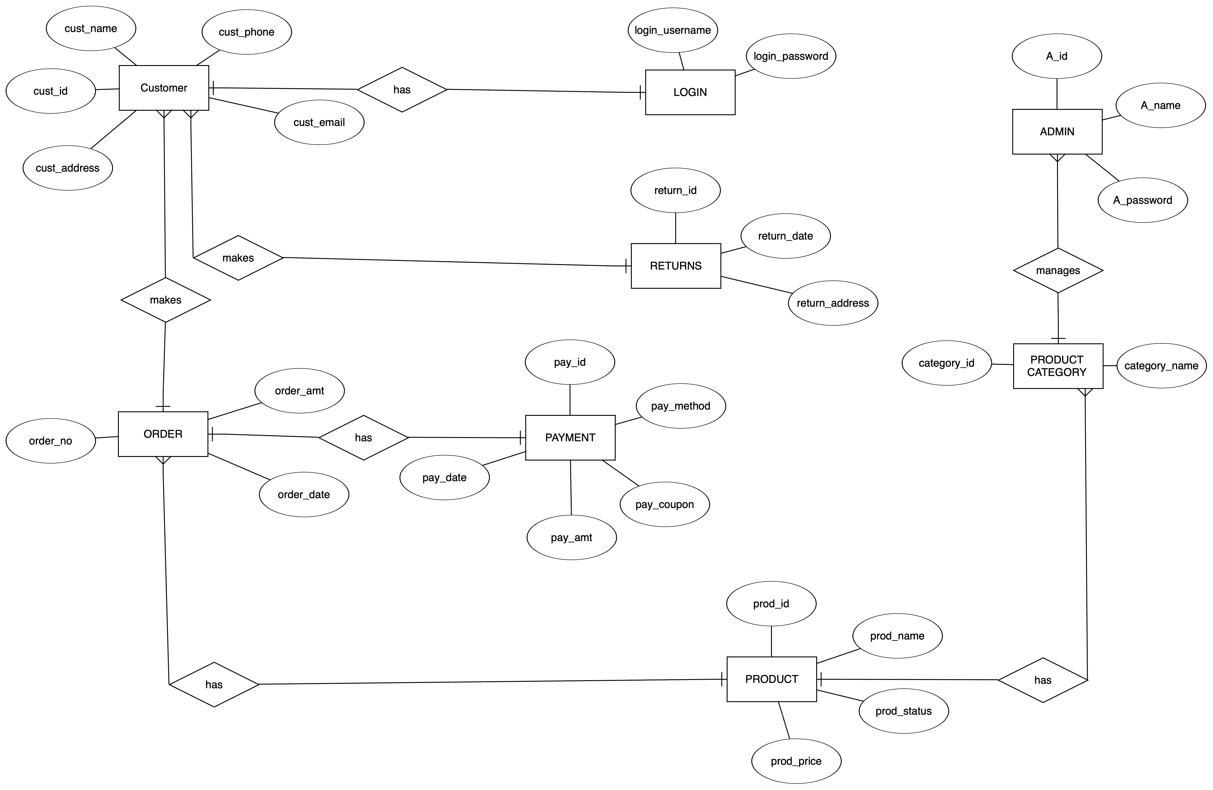
ER Diagram

Slide 37
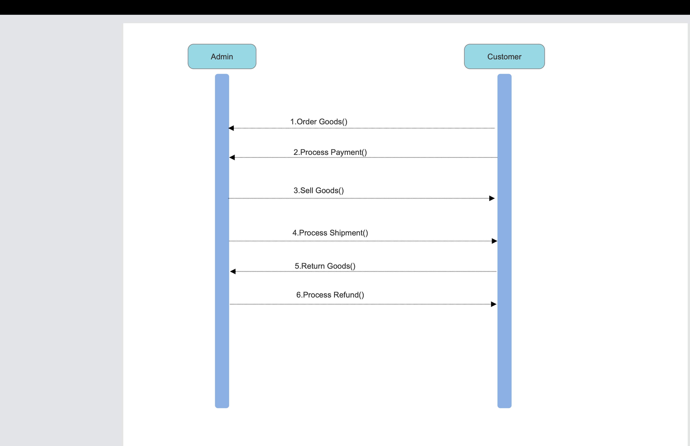
Sequence Diagram

Slide 38
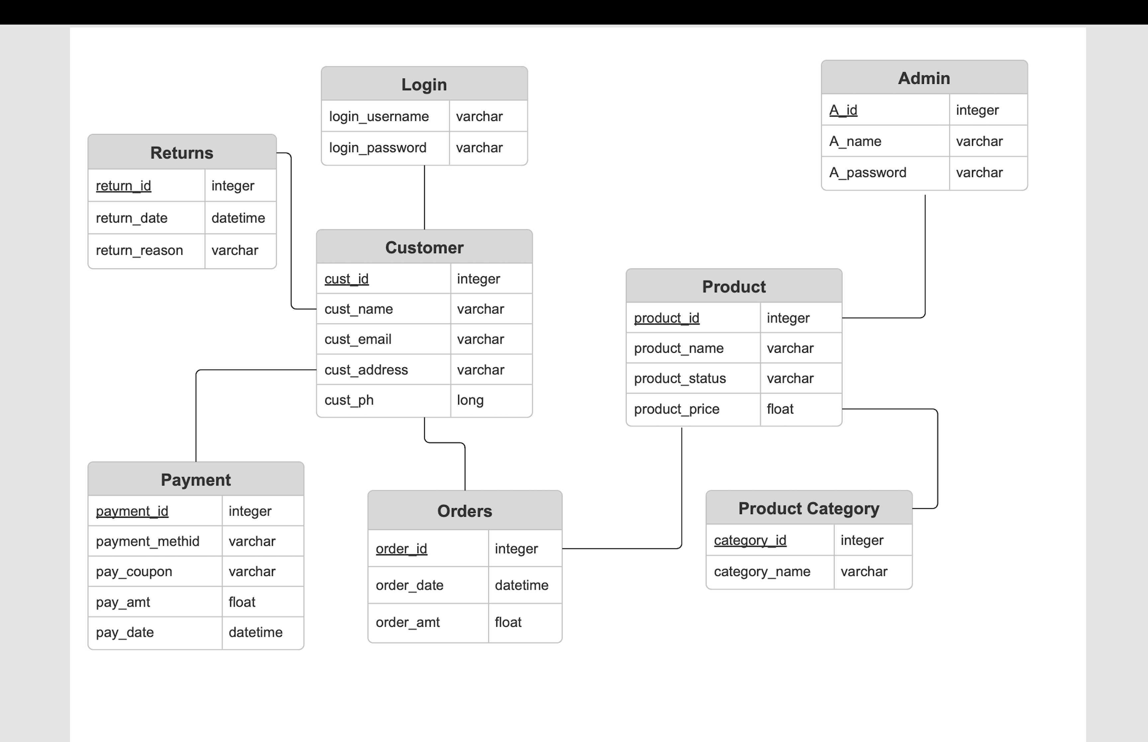
DB Diagram

Slide 39
THANK YOU!

